Slide 1
SI talk: drawing connections between TCR features and irAE development
2-1-2024
Ty Bottorff – Bioinformatics postdoc
Linsley lab

Slide 2
Outline

Slide 3
Immune checkpoints

Slide 4
Immune checkpoint blockade (ICB)
Notes:
Clinical outcome following checkpoint therapy in renal cell carcinoma is associated with a burst of activated CD8 T cells in blood: model: pool of tumor-specific TCF-1<sup>+</sup> stem-like CD8 T cells that aren't proliferating or generating antitumor effector cells that are a reservoir unleashed by ICB, seen by large burst of HLA-DR<sup>+</sup> CD38<sup+</sup> CD8 T cells after ICB and new repertoire
Distinct cellular mechanisms underlie anti-CTLA-4 and anti-PD-1 checkpoint blockade
- PD-1 blockade predominantly induces expansion of specific tumor infiltrating exhausted-like CD8<sup>+</sup> T cell subsets
- CTLA-4 blockade induces expansion of ICOS<sup>+</sup> Th1-like CD4<sup>+</sup> effector T cells, also engages specific subsets of exhausted-like CD8<sup>+</sup> T cells
Immune-related adverse events in checkpoint blockade: observations from human tissue and therapeutic considerations
PD-1 blockade more CD8 effect, CD4 effect more for CTLA-4 blockade
Mechanisms of immune-related adverse events during the treatment of cancer with immune checkpoint inhibitors
anti-CTLA-4 and anti-PD-1/PD-L1 antibodies called "immune enhancers" and "immune normalizers" (normalizing T cell immunity in tumor microenvironment), respectively, consistent with PD-1 blockade having less irAEs
T cell repertoire diversity: friend or foe for protective antitumor response?
high TCR diversity/richness/evenness (all same here, highly polyclonal synonyms) in blood associted with good ICB outcome
clonal replacement: recruitment of less dysfunctional peripheral T cell clonotypes to tumor that were not detectable in tumor prior to PD-1 blockade, i.e. from tumor draining lymph node, more important in ICI than previously thought**
- **clonal revival: replenishment of highly dysfunctional T cell clones in tumor with new, less dysfunctional T cells (perhaps from periphery, local expansion within tumor) that can be novel clonotypes (i.e. clonal replacement) or clonotypes pre-existing in tumor
tumor type matters for ICB response: melanoma/NSCLC have higher response rates, colon/endometrium cancers do not respond well to ICB (although those with high microsatellite instability and MMRd repsond well), tumor burden is a good predictor of ICB response (neoantigen generation to elicit antitumor immunity)
ovarian cancers ICB resistant, not known why (perhaps TIM-3 checkpoint), despite tumor-infiltrating leukocytes present in most ovarian cancer patients (or perhaps these are bystanders reactive to viruses rather than tumor antigens)
# A multi-omic single cell sequencing approach to develop a CD8 T cell specific gene signature for anti-PD1 response in solid tumors
- **neither pre-treatment TCR clonality nor changes in clonality after ICB correlate with response**

Slide 5
Immune-related adverse events (irAEs) from ICB
Notes:
Autoimmune toxicity occurs in up to 60% of patients treated with immune checkpoint inhibitor (ICI) therapy

Slide 6
Effect of tumor type on irAE incidence
irAE incidence does depend on tumor type, melanoma has higher frequency of skin and gastrointestinal irAEs but lower frequency of pneumonia compared to NSCLC patients, dermatitis, arthritis, and myalgia more common in melanoma patients than renal cell carcinoma patients, pneumonitis and dyspnea less common in melanoma
Notes:
165. Khoja L, Day D, Wei-Wu Chen T, Siu LL, Hansen AR. Tumour- and class-specific patterns of immune-related adverse events of immune checkpoint inhibitors: a systematic review. Ann Oncol. (2017) 28:2377–85. 10.1093/annonc/mdx286 [PubMed] [CrossRef] [Google Scholar]

Slide 7
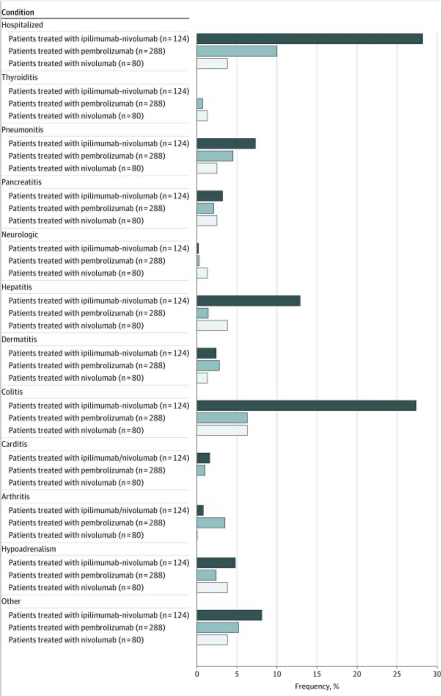
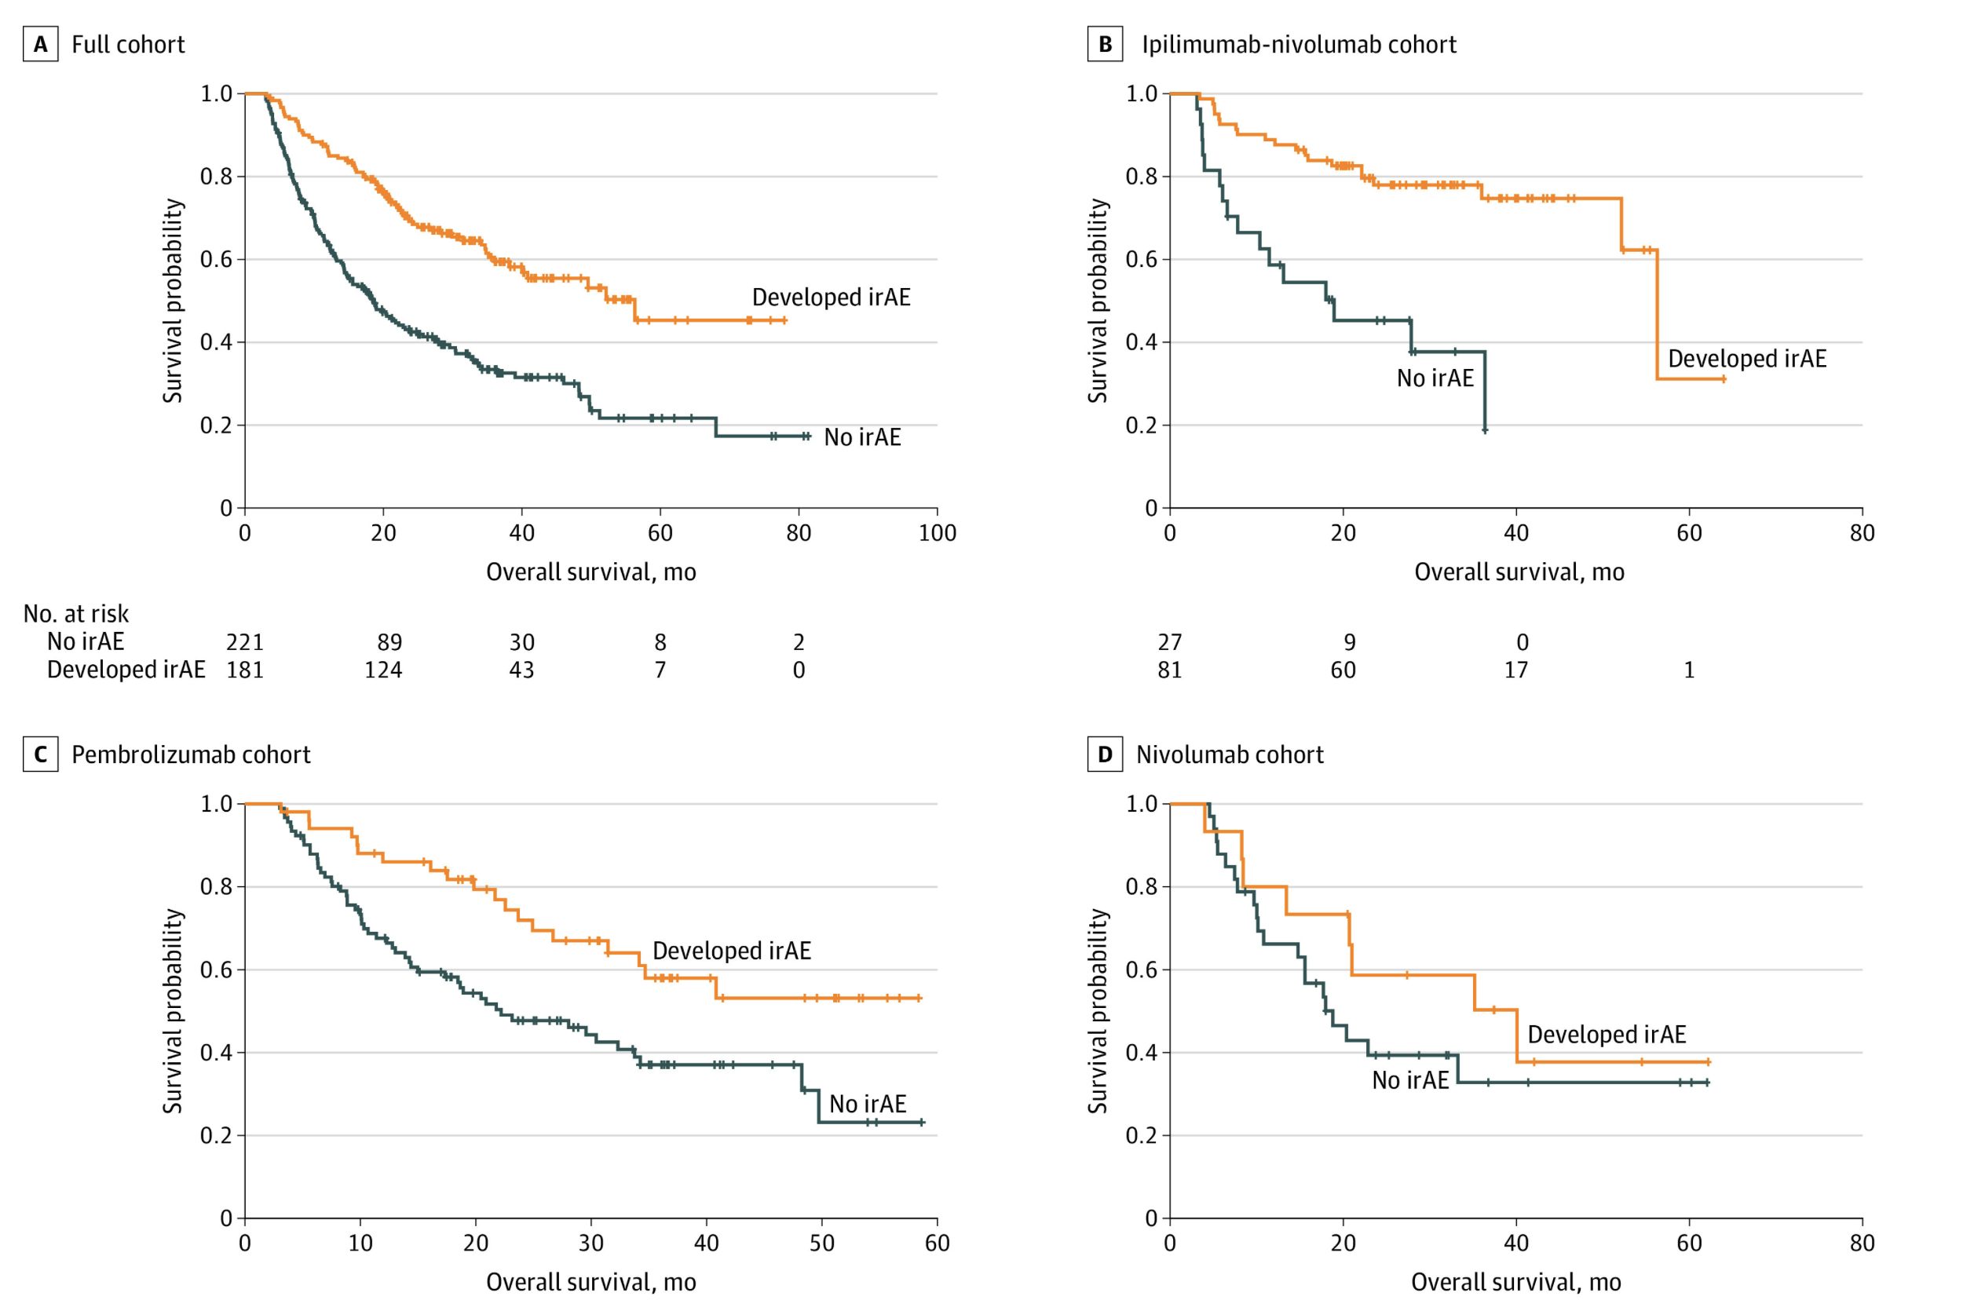
Immune-related adverse events (irAEs) from ICB are common and generally associated with anti-tumor response (PMID31021392, PMID26501224, PMID26446948)
Watson et al. JAMA Netw Open. 2022
Notes:
Ipilimumab: CTLA-4
In 2011, ipilimumab (Yervoy) became the first ICI to receive FDA approval for metastatic melanoma. As of 2023, it remains the only CTLA-4 targeting ICI that received FDA approval
Pembrolizumab/nivolumab: PD-1
T cell characteristics associated with toxicity to immune checkpoint blockade in patients with melanoma
Autoimmune toxicity occurs in up to 60% of patients treated with immune checkpoint inhibitor (ICI) therapy
Perhaps worth trying to make analogy between viral infections preceeding autoimmunity and tumor response preceeding irAEs?
Association of checkpoint inhibitor-induced toxic effects with shared cancer and tissue antigens in non-small cell lung cancer:
irAEs associated with response to therapy (also can cite Association of vitiligo with tumor response in patients with metastatic melanoma treated with pembrolizumab), also Nivolumab in resected and unresectable metastatic melanoma: characteristics of immune-related adverse events and association with outcomes
Characterization of anti-cancer immune response associated with immune-related adverse events in patients with kidney cancer (meeting abstract)
- more irAEs in ICB responders, not a new finding

Slide 8
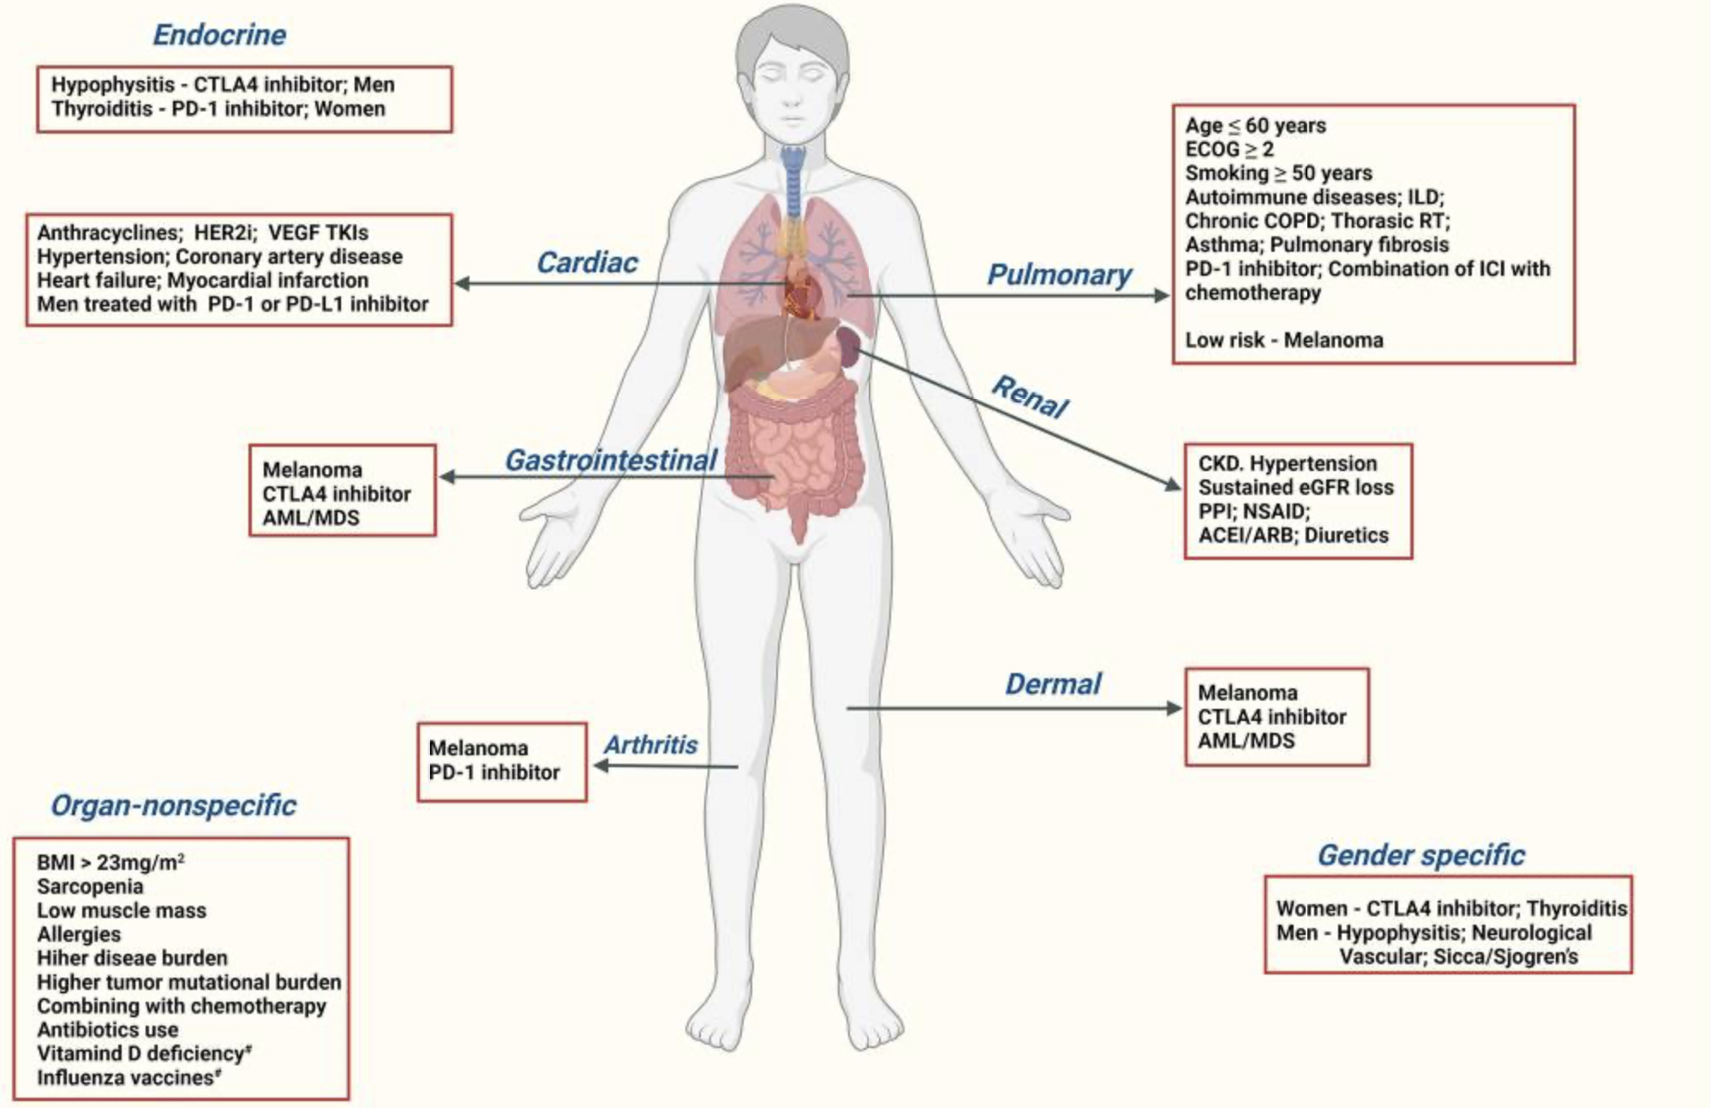
There are many proposed biomarkers for irAE development, but there exists a need for more reliable irAE prediction
Chennamadhavuni et al. Front Immunol. 2022
Notes:
Glehr et al. Front Immunol. 2022
unable to reliably predict risk of irAEs in most cases from pre-therapy flow cytometry and clinical data
Germline variants associated with toxicity to immune checkpoint blockade: IL7 cryptic exon, IL7 supports aberrant immune activity in autoimmunity, limits organ toxicity during antiviral immune response, blocks PD-1 leading to T1D (blocking checkpoint when it would have prevented autoimmunity, so IL7 acts as a natural ICB and is therefore rationally associated with irAEs
Biomarkers of checkpoint inhibitor induced immune-related adverse events - a comprehensive review: on treatment markers including clonal expansion of more T cell clones, more newly emerging T cell clones, decline in T cell clonality all very interestingly associated with more irAEs
External validation of biomarkers for immune-related adverse events after immune checkpoint inhibition: unable to reliably predict risk of irAEs in most cases from pre-therapy flow cytometry and clinical data
Germline variants associated with toxicity to immune checkpoint blockade: IL7 cryptic exon, IL7 supports aberrant immune activity in autoimmunity, limits organ toxicity during antiviral immune response, blocks PD-1 leading to T1D (blocking checkpoint when it would have prevented autoimmunity, so IL7 acts as a natural ICB and is therefore rationally associated with irAEs
T cell characteristics associated with toxicity to immune checkpoint blockade in patients with melanoma
activated CD4 effector memory T abundance and TCR diversity associated with irAE
in responsive patients peripheral compartment is a major source of T cells activated by ICB and majority of pre-existing intratumoral T cells are terminally exhausted and refractory to ICB
some circulating PD-1<sup>+</sup> CD8<sup>+</sup> T cells share TCR sequences with T cells in TME, and this frequency predicts ICB response
Checkpoint blockade-induced dermatitis and colitis are dominated by tissue-resident memory T cells and Th1/Tc1 cytokines
Single cell T cell landscape and T cell receptor repertoire profiling of AML in context of PD-1 blockade therapy
- TCR repertoires expand in responders, contract in therapy resistant patients

Slide 9
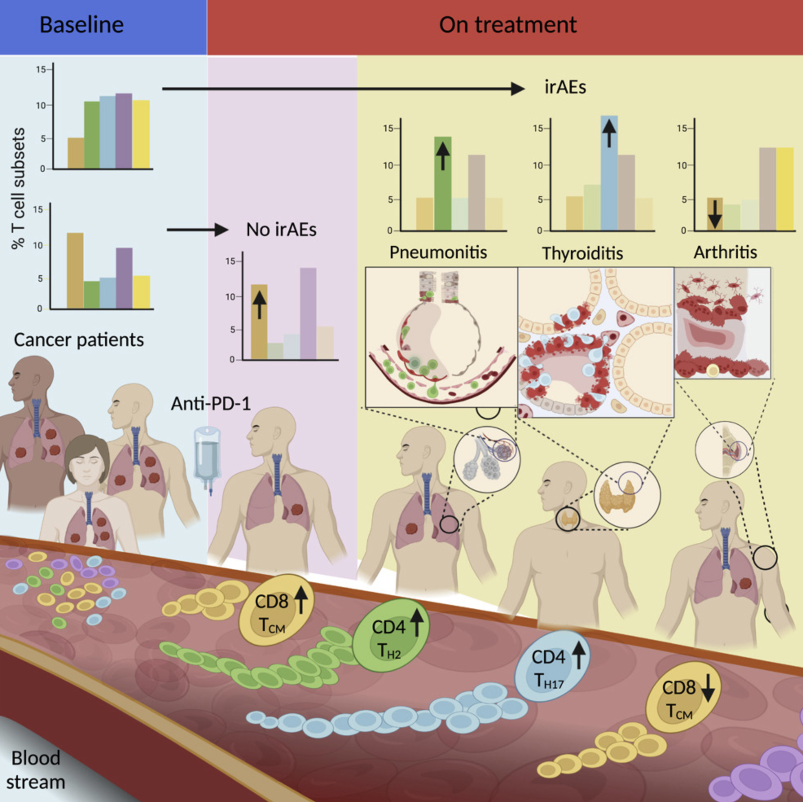
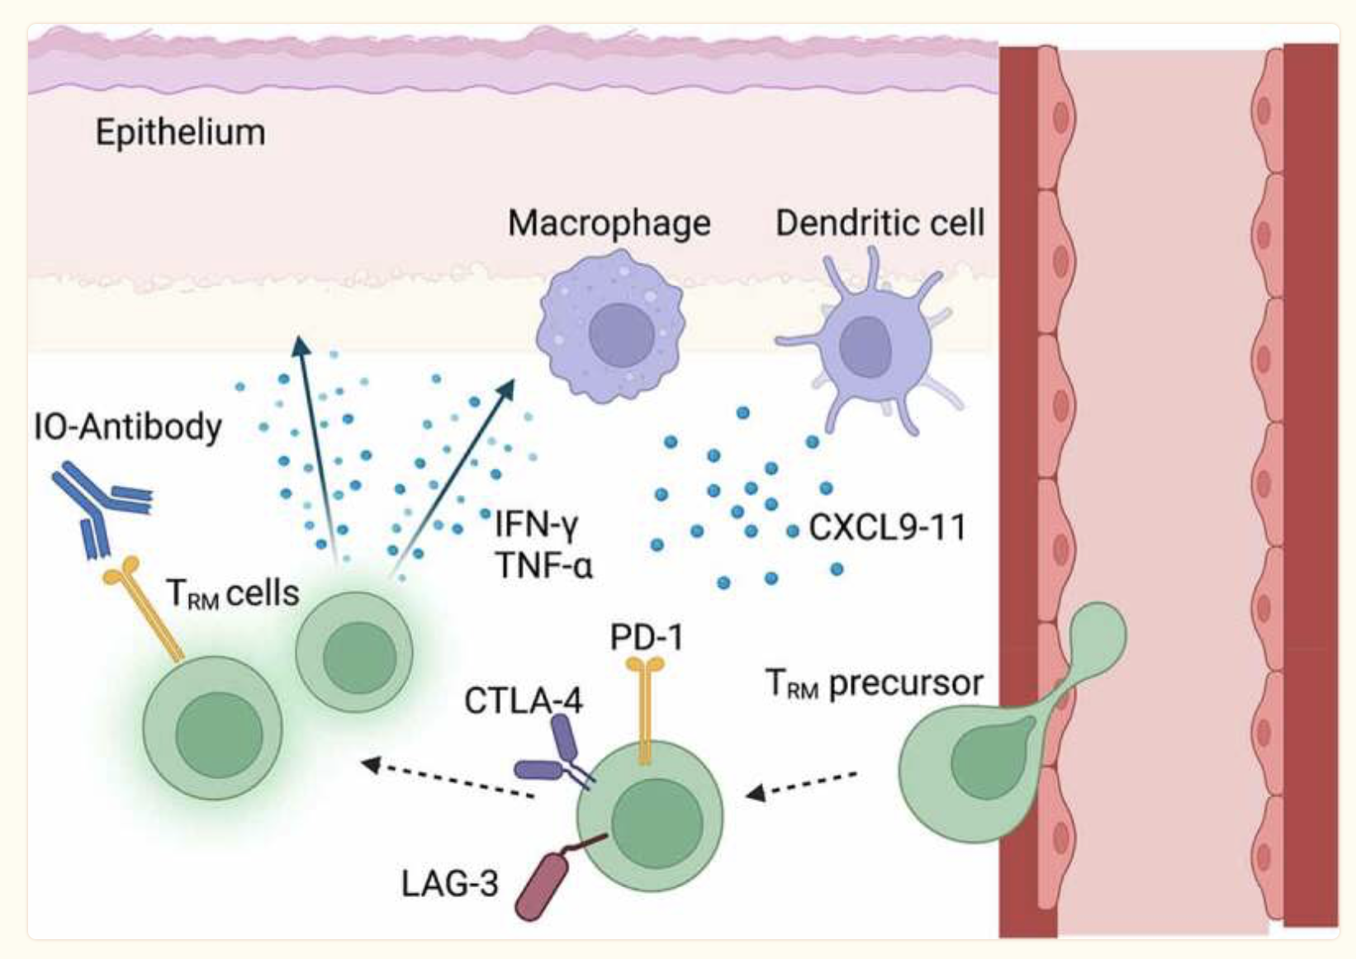
A focus on T cells in irAE development
Barrier organ irAEs dominated by Trm cells
Activated CD4 Tem abundance and TCR diversity associated with irAEs
Notes:
Left: Reschke R, Gajewski TF. Tissue-resident memory T cells in immune-related adverse events: friend or foe? Oncoimmunology. 2023 Apr 4;12(1):2197358. doi: 10.1080/2162402X.2023.2197358. PMID: 37035636; PMCID: PMC10078118.
Right: Bukhari S, Henick BS, Winchester RJ, Lerrer S, Adam K, Gartshteyn Y, Maniar R, Lin Z, Khodadadi-Jamayran A, Tsirigos A, Salvatore MM, Lagos GG, Reiner SL, Dallos MC, Mathew M, Rizvi NA, Mor A. Single-cell RNA sequencing reveals distinct T cell populations in immune-related adverse events of checkpoint inhibitors. Cell Rep Med. 2023 Jan 17;4(1):100868. doi: 10.1016/j.xcrm.2022.100868. Epub 2022 Dec 12. PMID: 36513074; PMCID: PMC9873824.
Clinical outcome following checkpoint therapy in renal cell carcinoma is associated with a burst of activated CD8 T cells in blood: model: pool of tumor-specific TCF-1<sup>+</sup> stem-like CD8 T cells that aren't proliferating or generating antitumor effector cells that are a reservoir unleashed by ICB, seen by large burst of HLA-DR<sup>+</sup> CD38<sup+</sup> CD8 T cells after ICB and new repertoire
clonal replacement: recruitment of less dysfunctional peripheral T cell clonotypes to tumor that were not detectable in tumor prior to PD-1 blockade, i.e. from tumor draining lymph node, more important in ICI than previously thought
- clonal revival: replenishment of highly dysfunctional T cell clones in tumor with new, less dysfunctional T cells (perhaps from periphery, local expansion within tumor) that can be novel clonotypes (i.e. clonal replacement) or clonotypes pre-existing in tumor
T cell characteristics associated with toxicity to immune checkpoint blockade in patients with melanoma
activated CD4 effector memory T abundance and TCR diversity associated with irAE
Checkpoint blockade-induced dermatitis and colitis are dominated by tissue-resident memory T cells and Th1/Tc1 cytokines

Slide 10
Importance of the irAE organ
lower baseline levels of CD8 TCM cells in arthritis irAE patients, higher CD4 Th2 baseline levels in pneumonitis irAE patients, higher CD4 Th17 baseline levels in thyroiditis irAE patients (PMID: 36513074)
low baseline circulating MAITs associated with irAE colitis (PMID: 32734627, ~coincides with my analysis)
activated CD4 TEM abundance (in PBMCs) associated with irAE development (PMID: 35027754, ~disagrees with my analysis)
possible explanation for differences between myocarditis-focused PBMC and colitis irAE tissue datasets & my analysis and published literature results

Slide 11
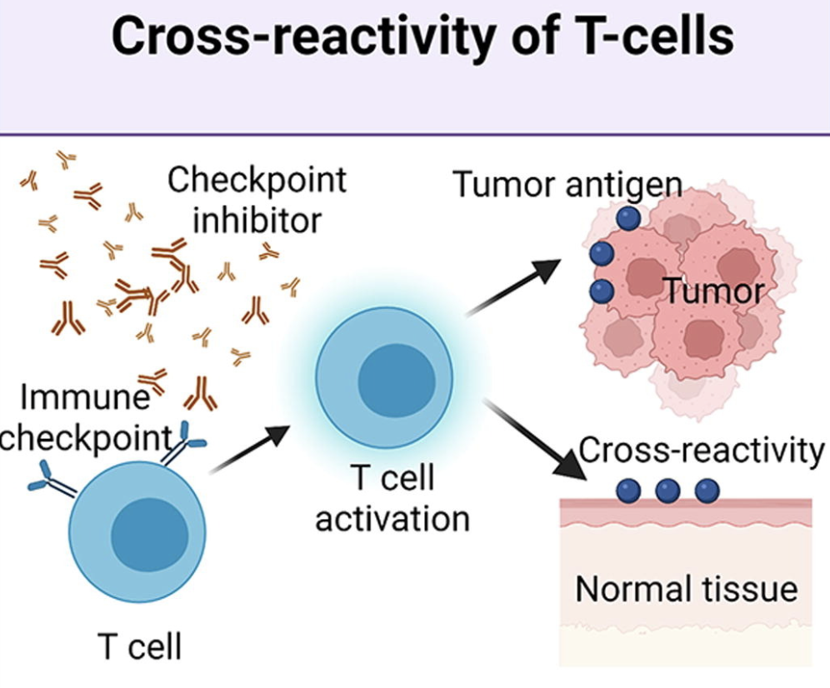
Hypothesis: crossreactive T cells may cause irAEs via reaction to both tumor and self
Supporting evidence
TCRs estimated to potentially react with 1 in ~10k encountered peptides (PMID37409132)
ICB remodels TCR repertoire (PMID28031229)
irAE development associated with T cell expansion (PMID27698113, PMID33597266, PMID33643899)
most similar tissue to tumor often has higher irAE incidence (PMID31021392)
infiltration of T cells in irAE tissue (PMID31021392, PMID35101349)
sharing between TCR clonotypes infiltrating primary tumor and irAE tissue (PMID31021392, PMID30832716, PMID34589959) and metastases and irAE tissue (PMID37680638)
more peripheral T cell clones shared with TILs in irAE patients (PMID30832716)
Zheng et al. Materials & Design. 2022
Notes:
Hommes et al. Front Oncol. 2021
on treatment markers including clonal expansion of more T cell clones, more newly emerging T cell clones, decline in T cell clonality all associated with more irAEs
Gouttefangeas et al. Front Immunol. 2023
TCR conceivably could recognize ~ 1 million peptides, crossreactive peptides likely often better agonists than original one that activated T cell, but few (~1%) of peptides are actually presented on MHC, so probably crossreactivity estimate closer to 1 in ~10,000
estimate TCRs to be able to bind ~10^5 to 10^6 peptides (Amino acid similarity accounts for T cell crossreactivity and for "holes" in the T cell repertoire)
Berner et al. JAMA Oncology, 2019
skin second most similar to NSCLC after lung and had second highest proportion of irAEs (also Autoreactive napsin A-specific T cells are enriched in lung tumors and inflammatory lung lesions during immune checkpoint blockade)
same T cell clonotypes infiltrated both lung tumor and autoimmune skin lesions
Speculation for what crossreactive T cells are actually targeting, perhaps T cells targeting cancer neoantigens cross-react with WT version of protein in healthy tissue (Autoreactive napsin A-specific T cells are enriched in lung tumors and inflammatory lung lesions during immune checkpoint blockade)
What makes TCRs crossreactive? cross-reactivity need not result from sequence similarity (3D structural similarity more important than 1D sequence similarity (Peter’s paper: Autoreactive T cell receptors with shared germline-like α chains in type 1 diabetes)
Kato et al. Journal of Clinical Oncology, 2023
- some irAE-provoked T cell clones circulate systemically and attack tumor cells leading to ICB response in irAE patients or vice a versa some tumor-provoked T cell clones circulate systemically and attack self leading to irAEs? not sure how they differentiate between the two
Subudhi et al. Proc Natl Acad Sci USA, 2016
CD8 T cell clonal expansion was greater in patients developing severe irAEs
Effective use of latent semantic indexing and computational linguistics in biological and biomedical applications: HLA-B57 restricted T cells are more crossreactive to mutants of target epitopes, this HLA allele also associated with autoimmunity
PMID: 33597266
- expansion of peripheral CD8+ T cell populations specific for melanocyte antigens observed only in patients who responded to anti-PD-1 therapy, so ICI can promote breakdown of tolerance towards tumor-lineage self-antigens
- perhaps in responders with low neoantigen tumors more often will see irAEs given necessity for immune activity against tumor associated antigens shared between tumor and self
Rapisuwon et al., J Immunother Cancer, 2019
identical CD8+ T cell clone found in 4 tissues in a patient with widespread irAEs (duodenum for enteritis irAE, PBMCs, original tumor and liver metastasis responses as well), evidence for crossreactivity underlying irAEs OR common antigen between tumor and self underlying irAEs
duodenitis blocked by antibody to integrin α 4 β 7 (LPAM-1) which blocks T cell infiltraton into GI tract, suggesting that GI toxicity resulted from circulating T cells trafficked to GI tract following expansion elsewhere i.e. in the tumor perhaps
Global analysis of shared T cell specificities in human non-small cell lung cancer enables HLA inference and antigen discovery: autoreactive T cells in peripheral blood may exist (pruned but not clonally deleted thymus) to avoid immunologic "blind spots" to pathogens, i.e. pathogens that look like self would get by free otherwise if we didn't have some autoreactivity perhaps
Heterogeneity of autoreactive CD8+ T cells at sites of inflammation
shared clonal origin among CD8+ T cells at site of colitis with gut Trm cells, suggesting clonal expansion from Trm population being responsible for irAEs (different from autoimmune, so for tissues that lack Trm cells, like the synovium, trafficking of T cells from the periphery may be important for irAEs)
PMID: 35101349
T cells seen infiltrating into irAE tissue, T cells seen targeting irAE tissue seen in blood, so T cells involved in irAEs
autoantibodies present ~50% of time for irAEs
Oh et al. Cancer Res. 2018
CTLA-4 blockade induced greater diversification of T cell repertoire (more clonotypes including newly detected clones, decreased clonality) in irAE patients compared to no irAE patients
Improved survival with T cell clonotype stability after anti-CTLA-4 treatment in cancer patients
diverse repertoires are important in limiting the magnitude of immune escape but may also promote self-reactive clones and induce host inflammation
Carbone et al. Front Immunol. 2023
they usually find different TCR sequences in vitiligo and primary melanoma lesions, so T cell response against normal melanocytes leading to vitiligo is not usually mediated by reactivation of T cell clones infiltrating/specific to primary melanoma but rather perhaps by T cells targeting metastatic tissues, so kind of different from my thinking of usually crossreactivity between primary tumor and irAE site but could also be crossreactivity between metastases and irAE sites
metastasis and vitiligo sample TCRs more similar than primary melanoma and vitiligo TCRs
Interpreting T cell crossreactivity through structure: implications for TCR-based cancer immunotherapy
crossreactivity driven by structural similarities of seemingly unrelated pMHCs (by sequence)
PMID: 34589959
can see same clonotypes of T cells reactive against tumor and self in irAEs
Trm cells locally expanded in irAE-dermatitis and –colitis
Other hypotheses: off-target effects (hypothalamus and pituitary express IC ligand), cytokine production damage normal tissue, autoantibodies, microbiome (proinfammatory)

Slide 12
Goal: determine if TCR (junction) features can serve a proxy for T cell cross-reactivity
Features to investigate
Junction length (PMID33289628, PMID12152083, PMID9597140), chemical properties (PMID35177831)
TCR germline-ness (probability of generation)
Possible effects of feature variations
Altered TCR-pMHC contact geometry, binding modes, number of contacts
Notes:
Additional possible effect that I’m not sure how to talk about: altered diversity?
Initially thought that more germline-like TCRs might be more cross-reactive as they have lower sequence complexity, don’t fully understand that hypothesis though…
Hydrophobicity: more hydrophobic TCRs might be more cross-reactive as they allow more alternative contacts
Entropic contributions and the influence of the hydrophobic environment in promiscuous protein-protein association: interface demonstrates promiscuity in part due to the number of interactions this hydrophobic interface allows, which allows many alternative contacts (increased entropy, drives forward binding) with other binding partners hence promiscuity
Repertoire analyses reveal T cell receptor sequence features that influence T cell fate
TRB CDR3 hydrophobicity promotes reactivity to self-peptides
Functionally specialized human CD4+ T cell subsets express physiochemically distinct TCRs: longer CDR3s might promote crossreactivity
Statistical analysis of CDR3 length distributions for the assessment of T and B cell repertoire biases:
The length of the CDR3 loop greatly influences its shape and ability to fold both on itself and in the company of others loops such as the CDR1 and CDR2

Slide 13
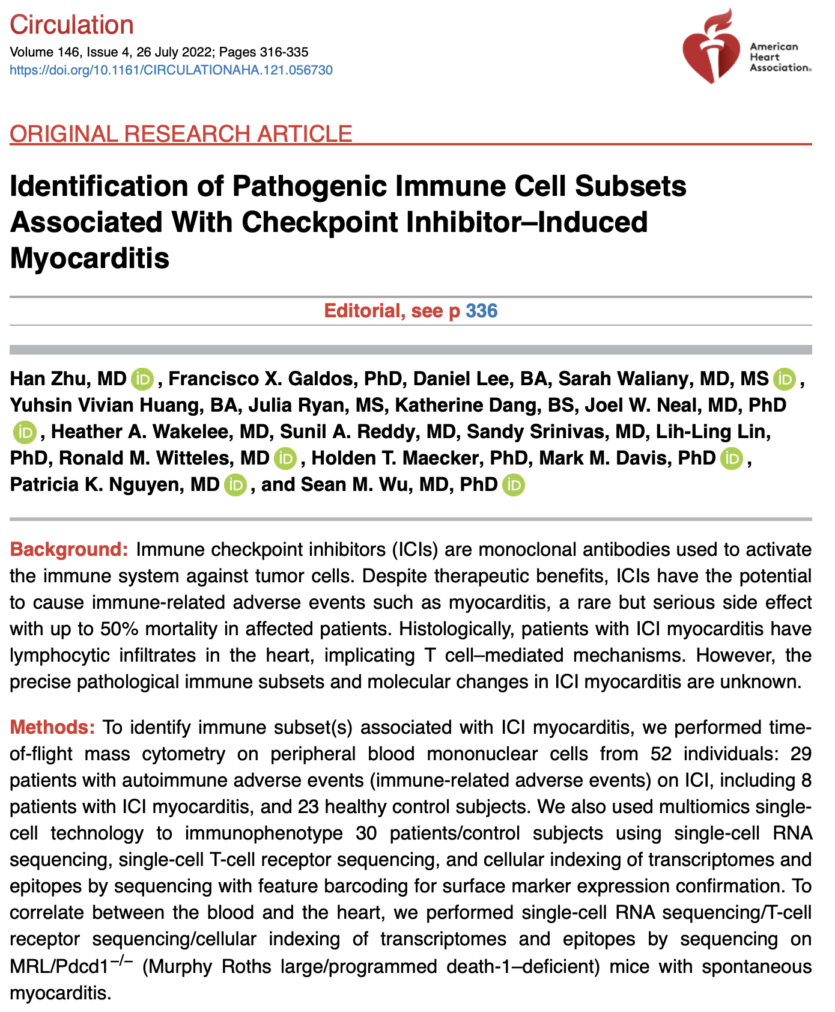
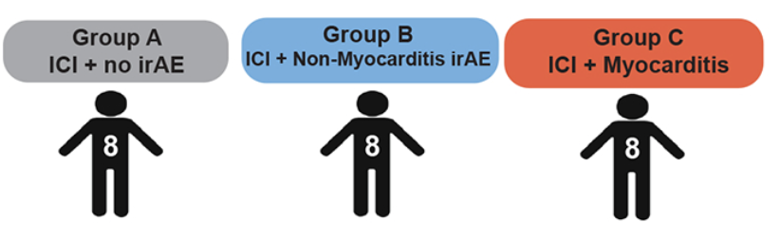
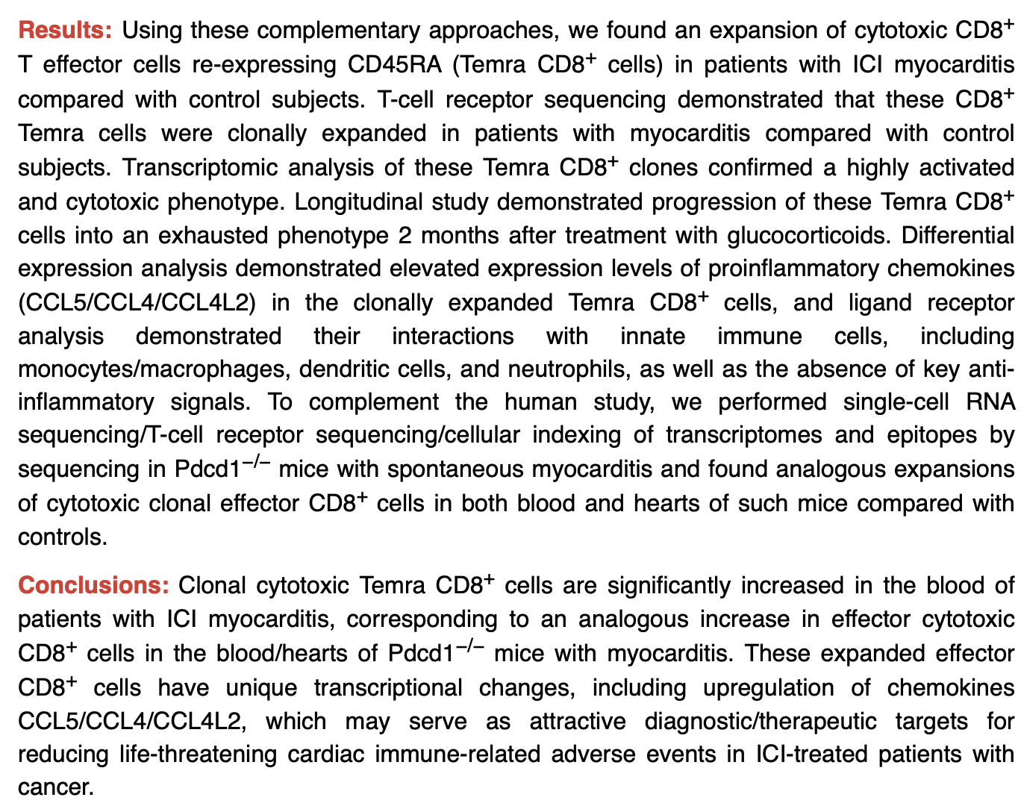
Pooled groups B & C for power
(still observe same trends if not pooled)
Notes:
Stress recency! 2022!

Slide 14
Colitis dataset intro slide like last slide

Slide 15
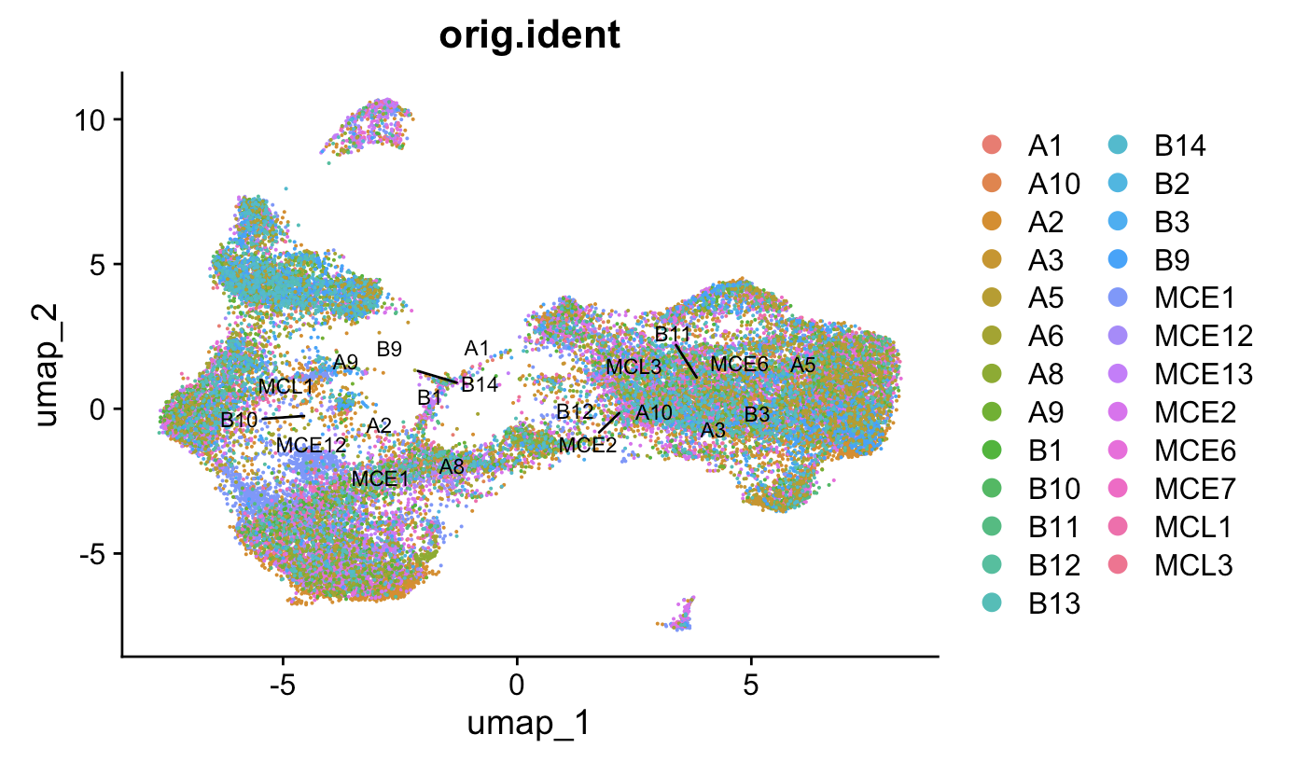
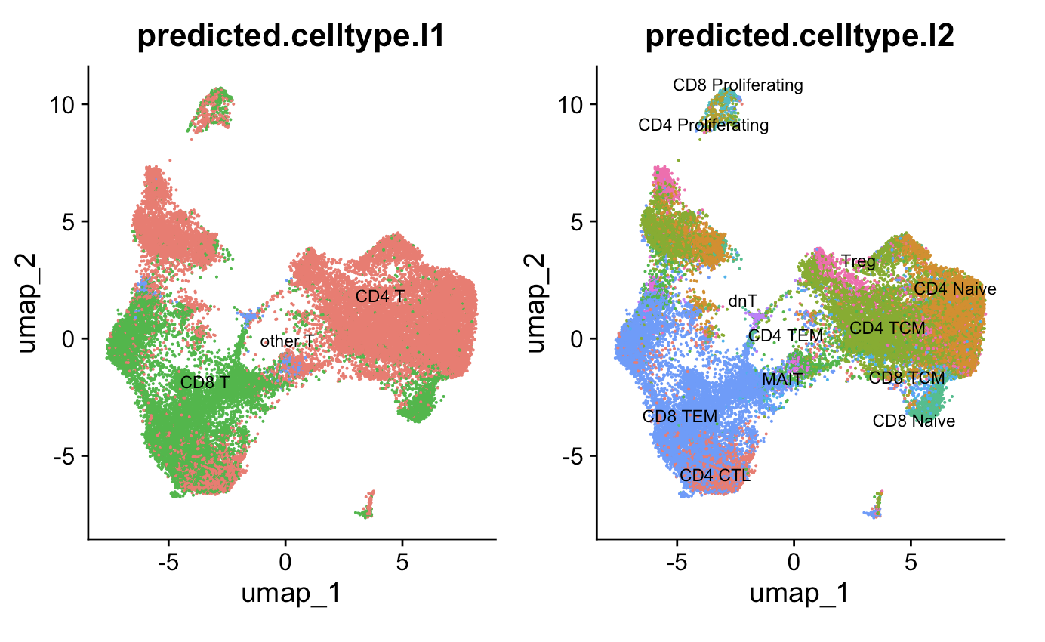
Methods (update for colitis too)
Patient ID
Quality control, filter out ~50k cells, obtain ~180k cells
Data normalization
Highly variable feature selection
Data scaling
Dimensional reduction
Clustering of cells
Reference map clusters to identify cell (sub)types
Remove non-T cells, repeat steps 5-7, obtain ~30k T cells
Use Stitchr package (PMID35325179) to produce TCR sequences from VJ and CDR3 sequences
CDR3 length and TCR probability of generation (pgen, PMID29422654) analyses for unique TCRs of top clonotypes
Notes:
Gloss over 1-7
If sharing downsampling... downsample reads per patient → ~4k T cells
Stitchr: basically looks for sequence matches between N terminus and C terminus of junction and V gene, incrementally deleting V gene residues until it finds junction. Then use non-V portion of CDR3 to search J gene, then remainder for search D gene (TRB). Then get seq by trim reference and use most common codon for species
IGoR: IGoR starts by listing the possible recombination and hypermutation scenarios leading to an observed sequence in the data set, then assigns probability weights reflecting the likelihood of these scenarios, IGoR restricts its exploration to the reasonably likely ones to save on computational cost
computational pipeline: V(D)J recombination proceeds by joining randomly selected segments (V, D, and J segments in the case of TRB and IGH), each segment gets trimmed at its ends (hashed areas), and a varying number of non-templated insertions are added between them, IGoR lists putative recombination scenarios consistent with the observed sequence, and weighs them according to their likelihood, the likelihood of each scenario is computed using a Bayesian network of dependencies between the recombination features (V, D, J segment choices, insertions, and deletions)
QC/metrics:
Mitochondrial RNA < 15%
> 500 unique RNAs/cell
181,403 cells remain after QC (50,524 cells dropped)
30,136 T cells (before downsample)
328 TCRs/patient (24 patients) downsampling = 7872 total TCRs after downsampling

Slide 16
Heatmap methods
Calculate clonotype (chain-CDR3-V-J) counts within each patient
If not downsampling, normalize clonotype counts within each patient by sum of clonotypes for that patient (sequencing depth)
Slice to only look at unique clonotypes from each patient
Arrange by (normalized if not downsampled) clonotype counts within cell type, chain groups
Create 10 bins per cell type, chain group, i.e. bin 1 is top 10% clonotypes for that chain-cell type across patients
Perform Wilcox rank sum test iteratively up to n^{th} bin within cell type, chain groups for features of interest
Create heatmaps of –log10(p value) by cell type, chain, feature groups across % repertoire bins

Slide 17
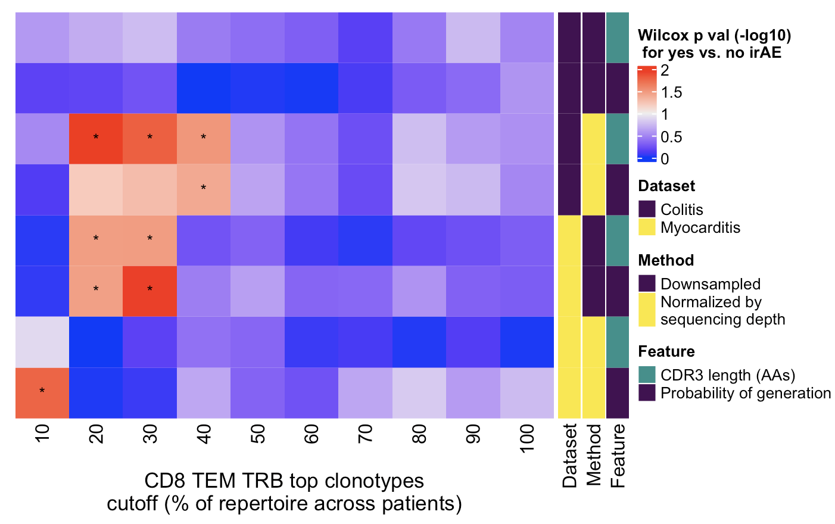
Results
Wilcoxon rank sum test. *; p <0.05
Notes:
only a small portion of an antigen is needed to be recognized by a TCR (8-10 amino acids for MHCI, 14-18 for MHCII, does this mean that CD8<sup>+</sup> T cells might be more cross-reactive?)
T cell repertoire analysis and metrics of diversity and clonality
CDR1-2 contact MHC and CDR3 contacts peptide is the general rule, but CDR1α also contacts peptide and CDR3β doesn't contact peptide too much
The length of the CDR3 loop greatly influences its shape and ability to fold both on itself and in the company of others loops such as the CDR1 and CDR2 (Davis et al., 1998, Wu et al., 2002): https://www.sciencedirect.com/science/article/pii/S0161589006002148?via%3Dihub

Slide 18
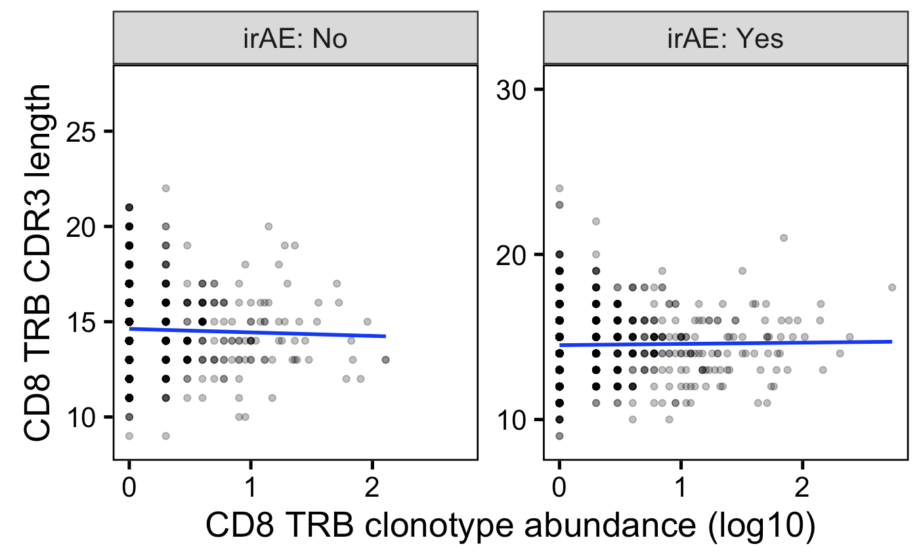
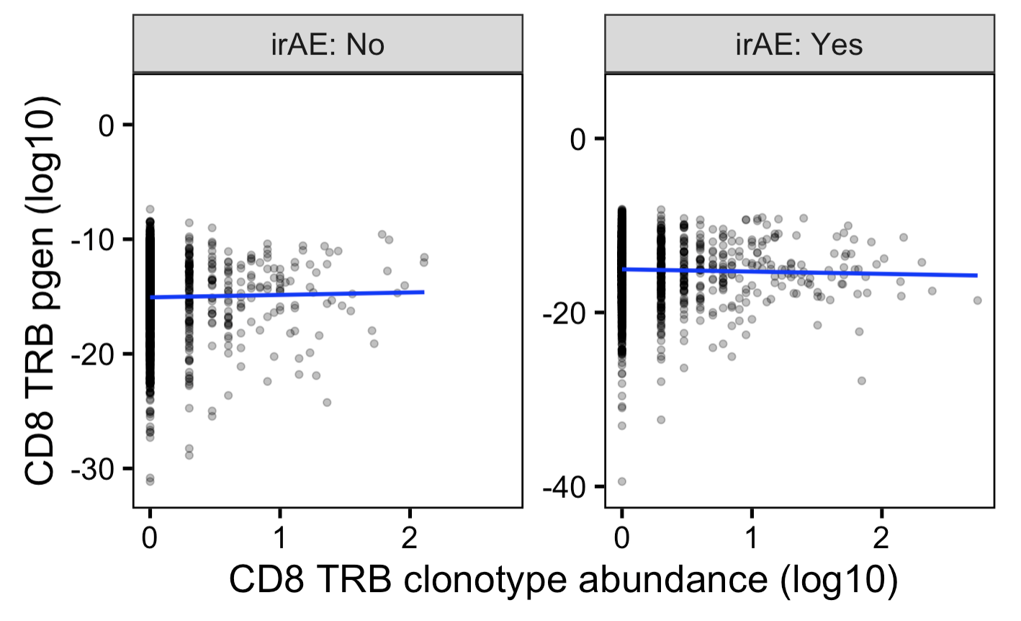
In myocarditis dataset, can see small differences in best fit slopes for feature vs. clonotype abundance plots for yes/no irAE also do for colitis dataset
Unique TCRs
→
More germline-like
Less germline-like
→
Notes:
Slope differences much bigger if no log10 x-axis scale, but then all squished in x-axis

Slide 19
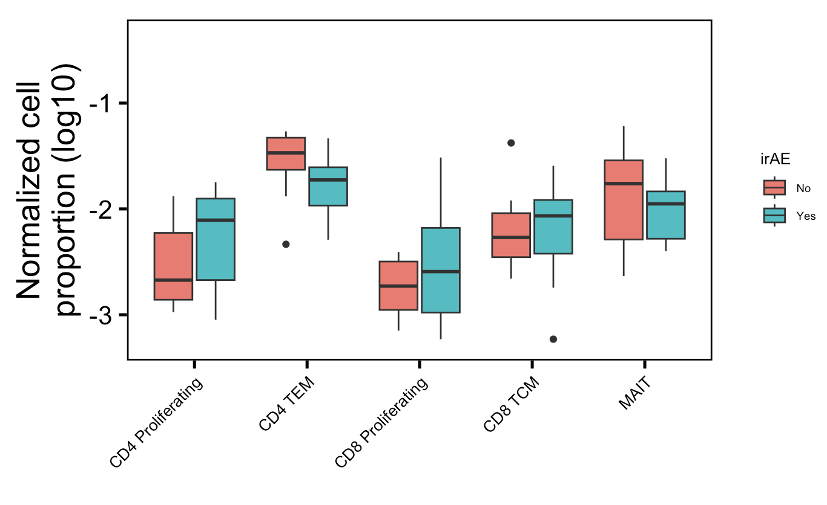
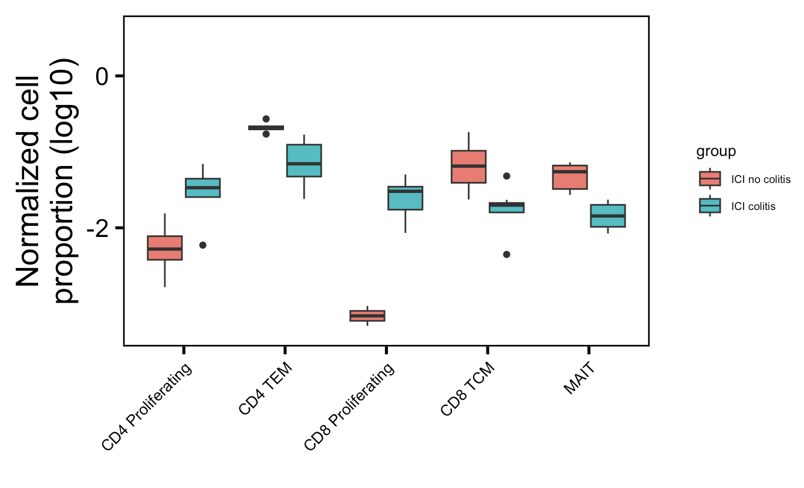
More proliferating T cells, fewer memory T cells (CD4 TEM, CD8 TCM), fewer MAITs in irAE colitis tissue: normalized by sequencing depth approach
Myocarditis dataset
Colitis dataset
**
**
*
**
**
None significant even with t test instead of Wilcox rank sum test
Wilcoxon rank sum test. **, p <1e-2; *; p <0.05
Notes:
Fewer Tregs associated with irAEs in literature, don’t see that here though, don’t even see ICI decreasing Tregs…
Wilcox rank sum test doesn’t assume equal variances (t test does)
~similar to what I see here: low baseline circulating MAITs associated with irAE colitis (PMID: 32734627)
~opposite to what I see here: activated CD4 TEM abundance (in PBMCs) associated with irAE development (PMID: 35027754)

Slide 20
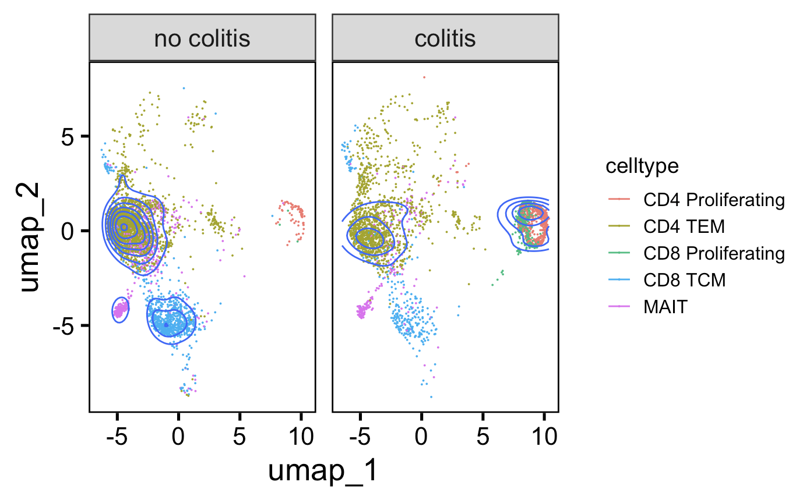
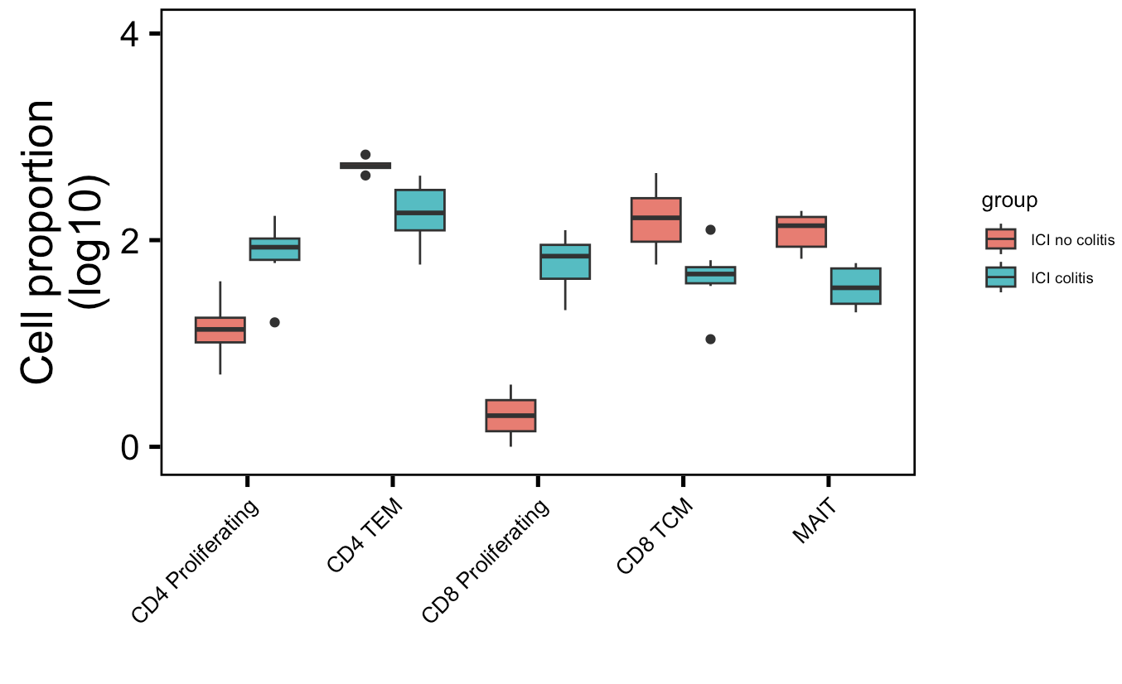
More proliferating T cells, fewer memory T cells (CD4 TEM, CD8 TCM), fewer MAITs in irAE colitis tissue: downsampling approach
Downsampled
**
**
*
**
**
Wilcoxon rank sum test. **, p <1e-2; *; p <0.05
Notes:
Fewer Tregs associated with irAEs in literature, don’t see that here though, don’t even see ICI decreasing Tregs…
~similar to what I see here: low baseline circulating MAITs associated with irAE colitis (PMID: 32734627)
~opposite to what I see here: activated CD4 TEM abundance (in PBMCs) associated with irAE development (PMID: 35027754)

Slide 21
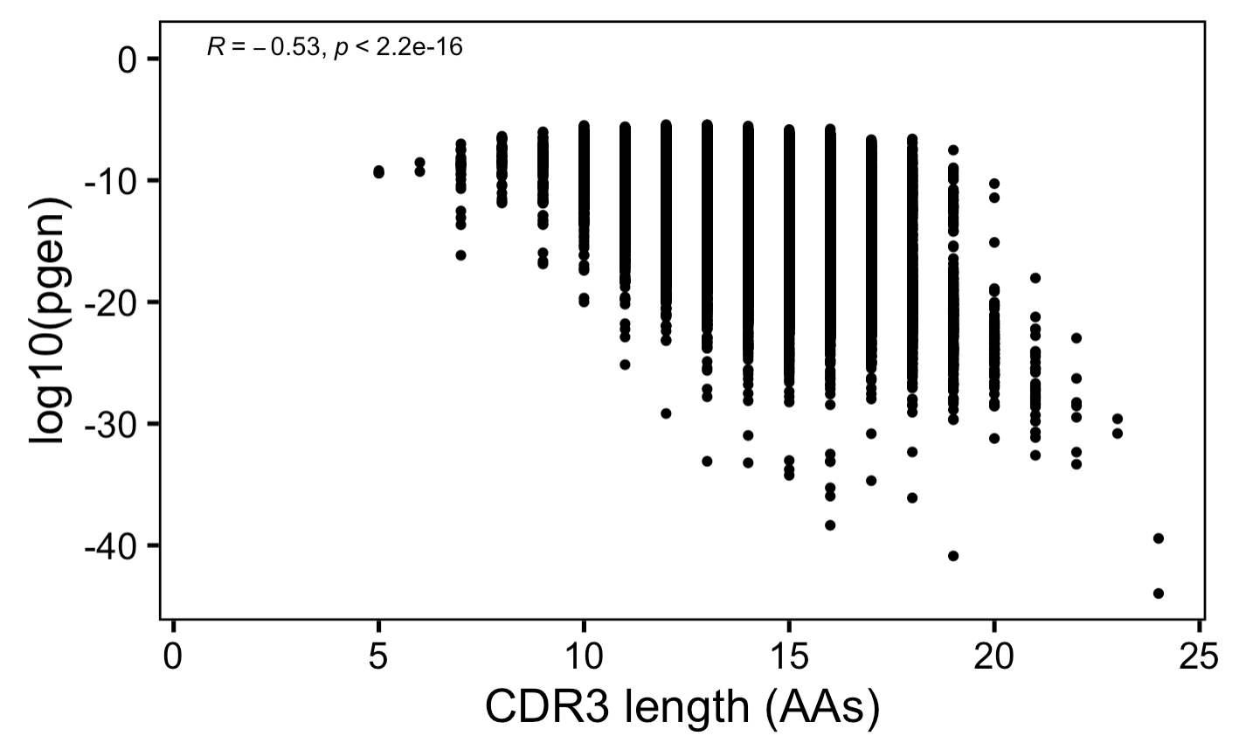
Anticorrelation between CDR3 length and germline-ness update as facet for both datasets
→
More germline-like
Less germline-like
→

Slide 22
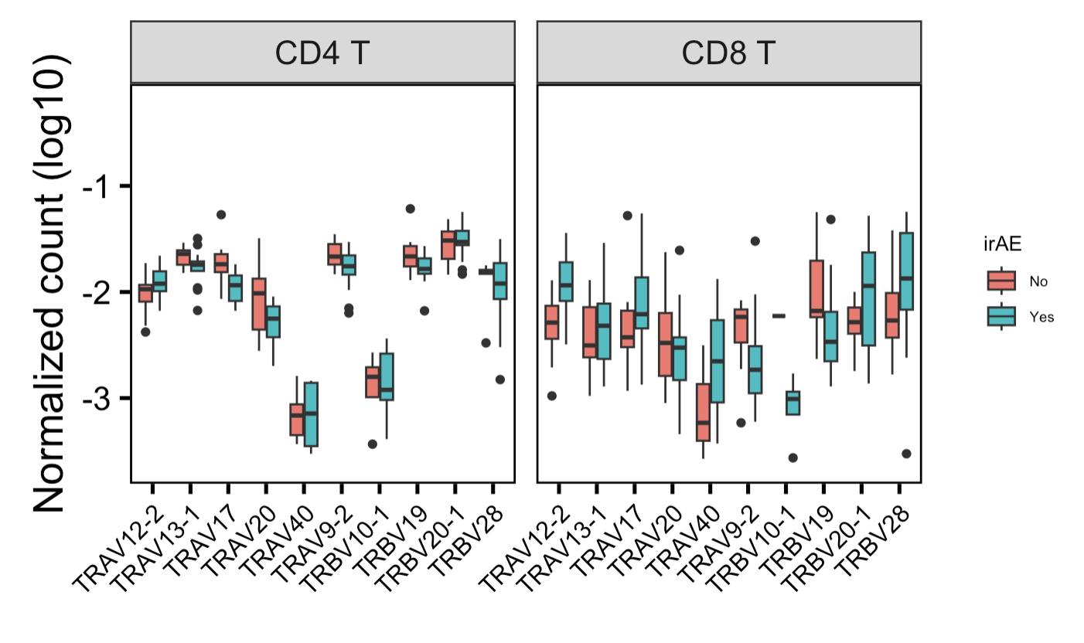
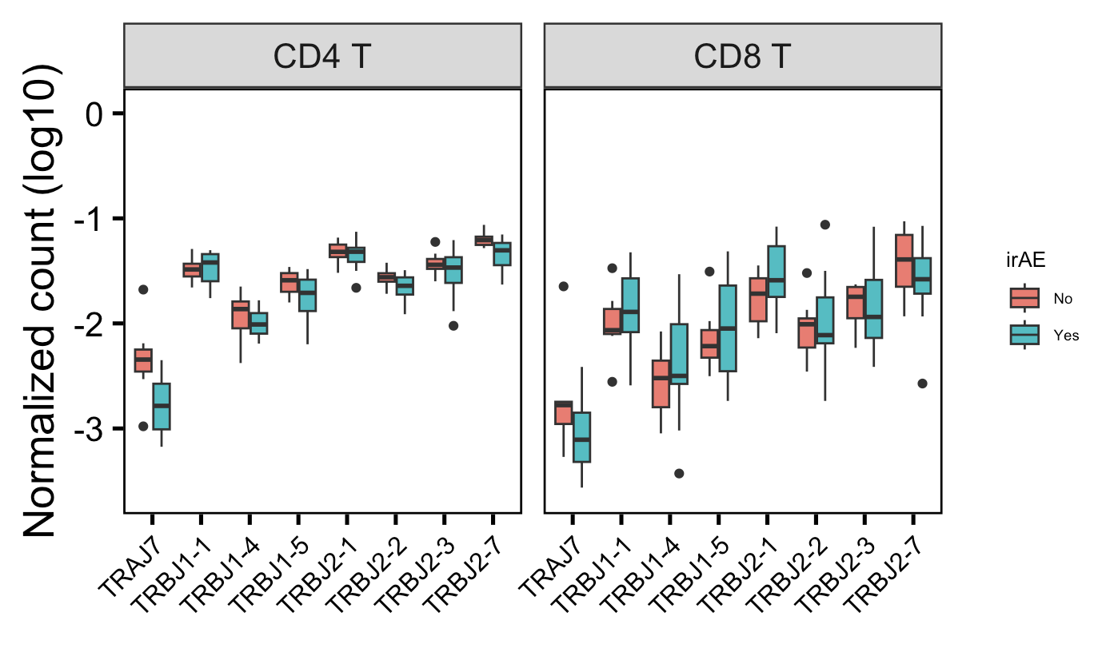
In myocarditis dataset, a few VJ genes are differentially encountered in different irAE groups cleanup to just be significant ones shown, show in both datasets?
*
*
**
Showing 10 V/J genes with highest differences in median normalized counts between irAE groups
Wilcoxon rank sum test. **, p <1e-2; *; p <0.05

Slide 23
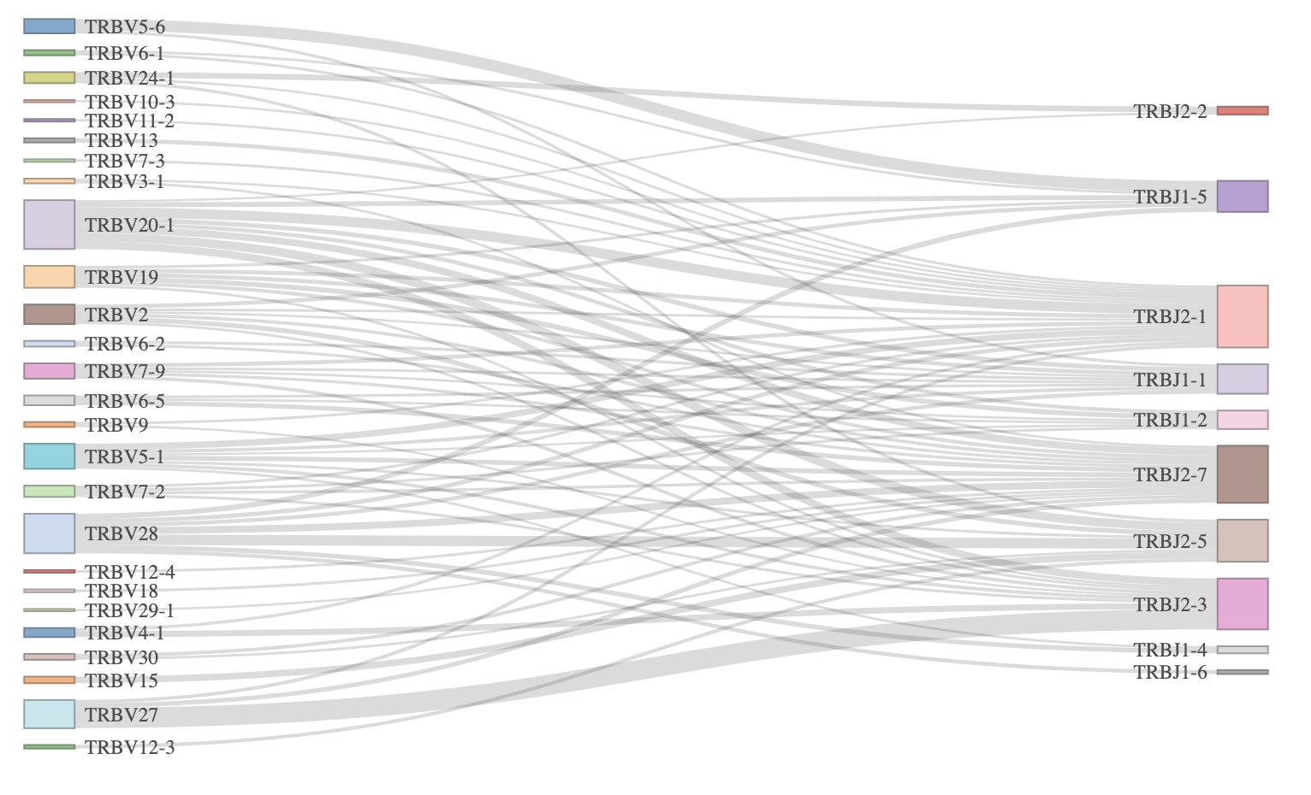
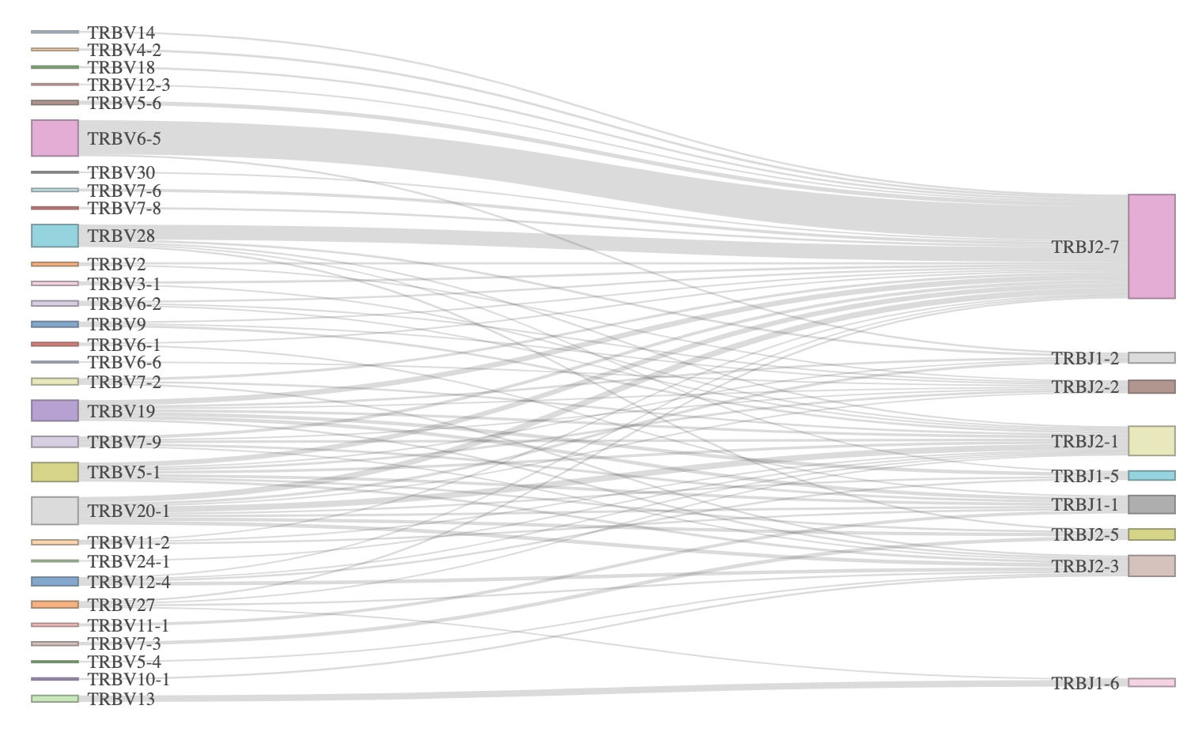
TRB VJ linkages look different in yes vs. no irAE groups, perhaps could also explain pgen differences
Yes irAE
No irAE
Myocarditis dataset
Notes:
Filtered for top 75 most common linkages

Slide 24
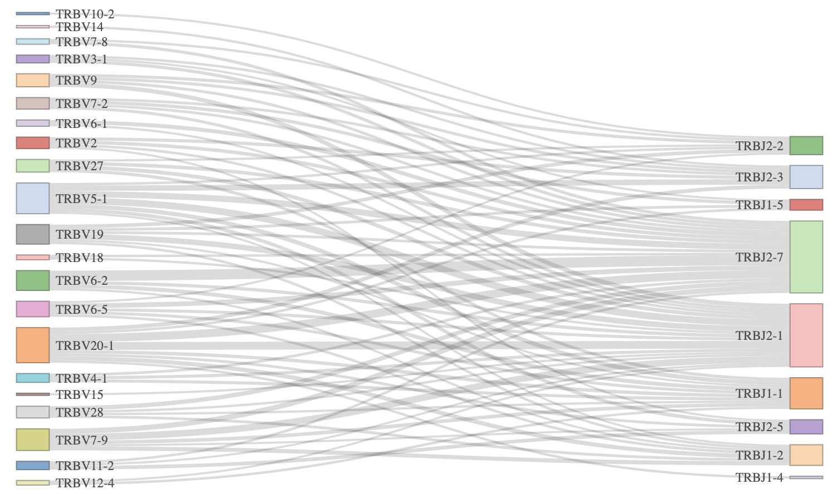
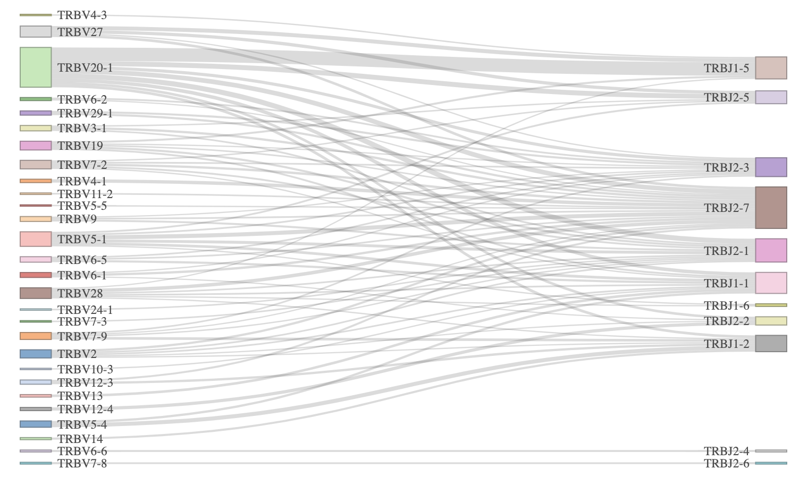
TRB VJ linkages look different in yes vs. no irAE groups, perhaps could also explain pgen differences
Yes irAE
No irAE
Colitis dataset
Notes:
Filtered for top 75 most common linkages

Slide 25
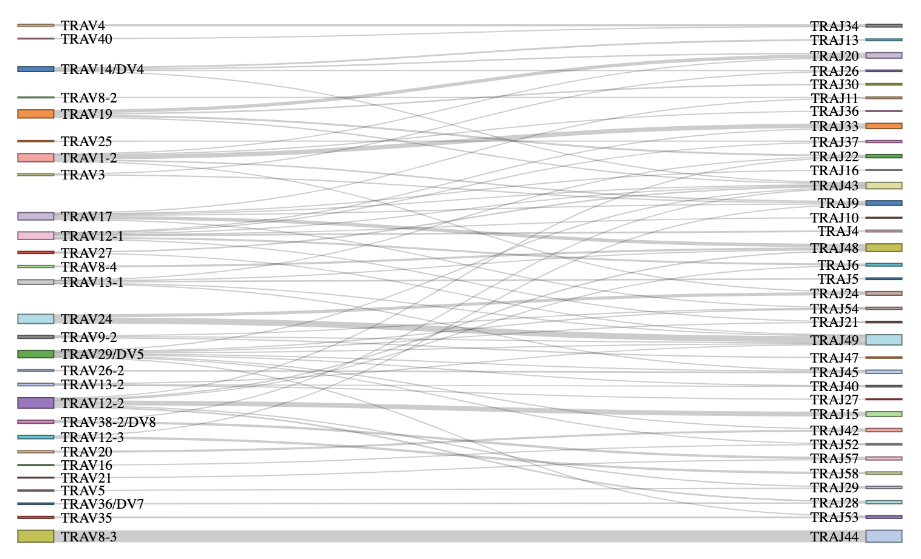
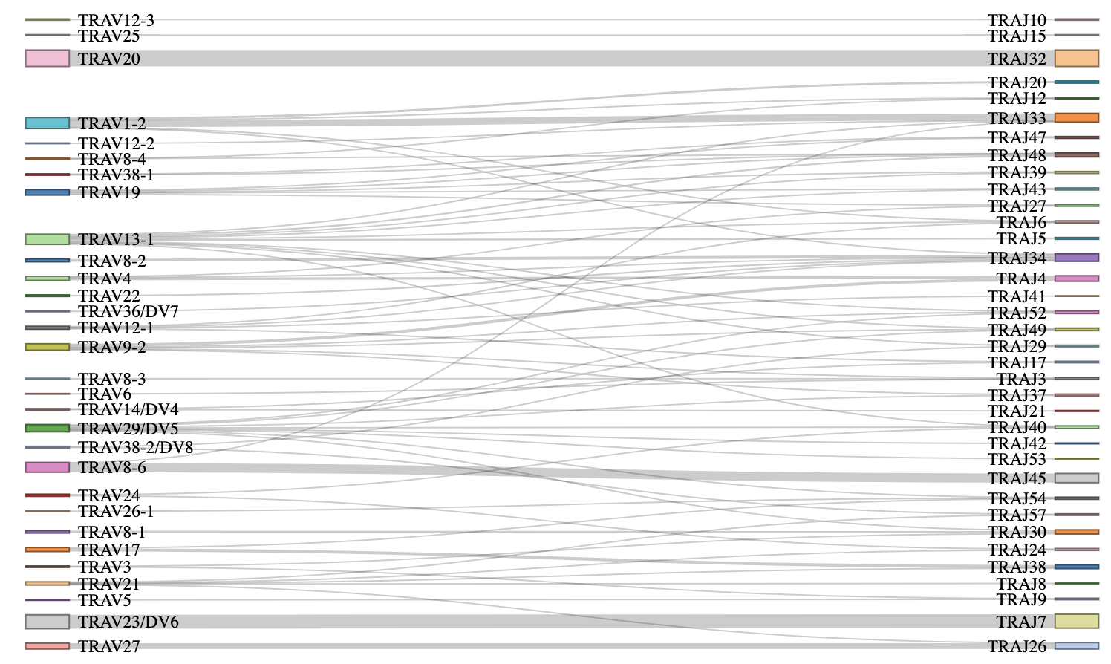
TRA VJ linkages also look different in yes vs. no irAE groups despite no pgen differences
Yes irAE
No irAE
Myocarditis dataset
Notes:
Filtered for top 75 most common linkages

Slide 26
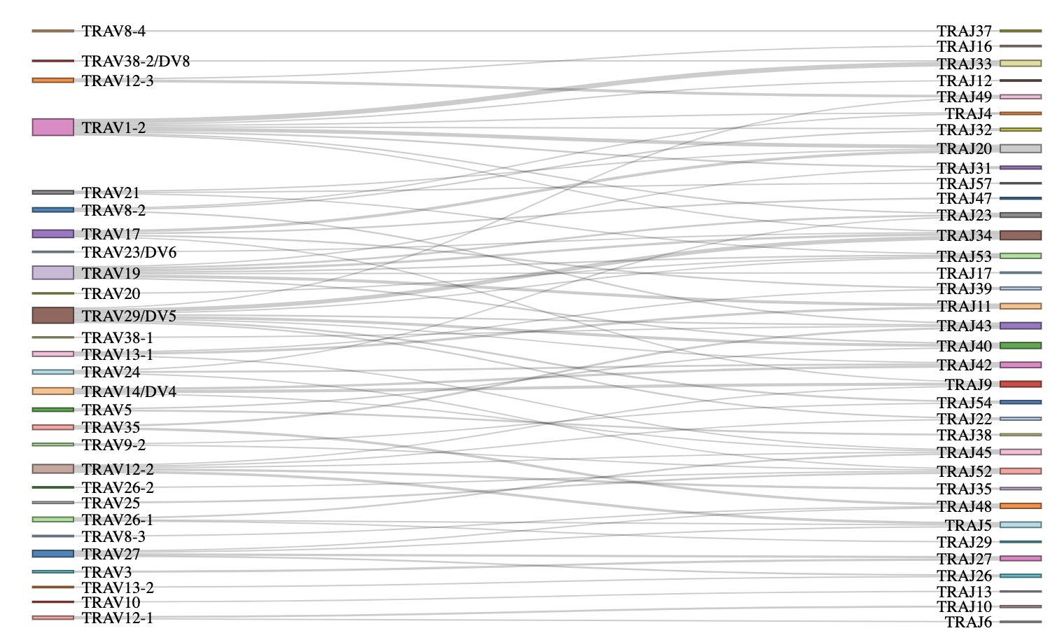
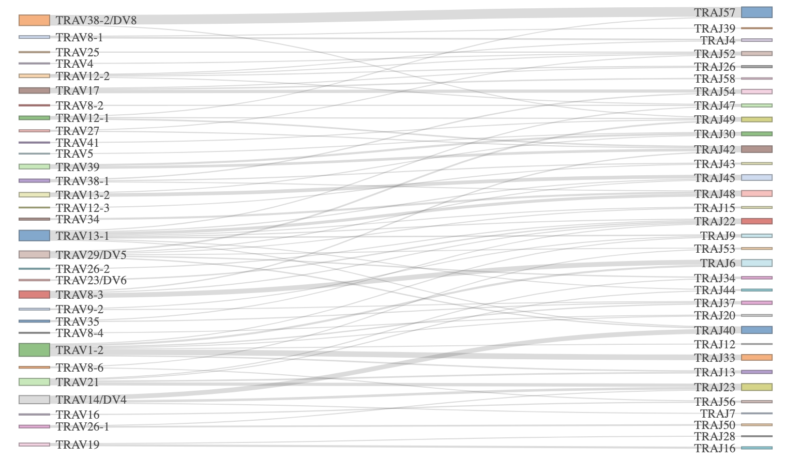
TRA VJ linkages also look different in yes vs. no irAE groups despite no pgen differences
Yes irAE
No irAE
Colitis dataset
Notes:
Filtered for top 75 most common linkages

Slide 27
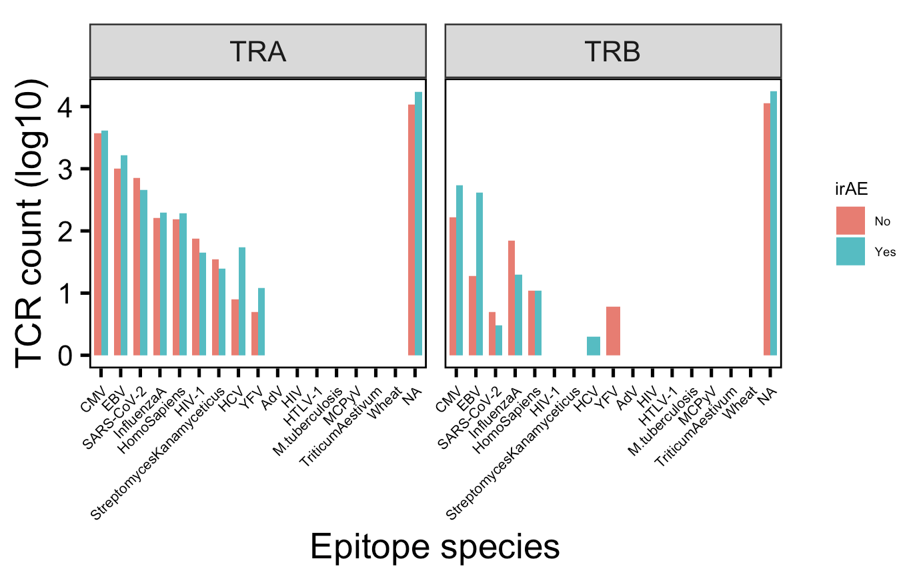
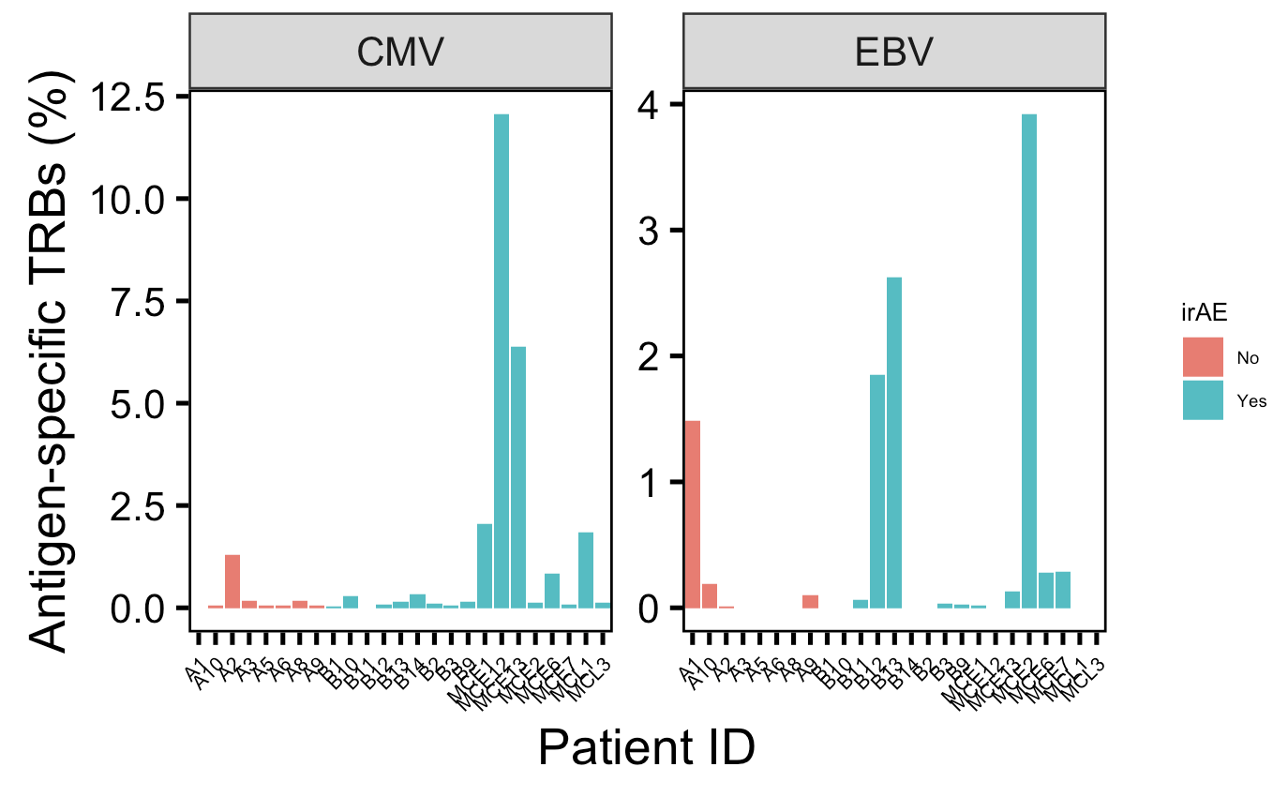
There are many more TRBs specific for CMV and EBV in those developing irAEs, mostly driven by a few patients
Notes:
Perhaps related to connection between infections before autoimmune development? Or just bystanders?
VDJdb mostly MHC class I (80k, 4k class II)

Slide 28
Conclusions
Within highly expanded CD8 TEMs in those developing irAEs…
slightly longer CDR3Bs
less germlike-like TRBs
We can mine public data and use it in tandem with BRI data, for example using one as a training set and the other as a test set
Increased confidence in conclusions that are recapitulated across multiple datasets
Increased breadth of possible research questions to investigate
Notes:
Identification of neoantigens for individualized cancer immunotherapy
cross-reactivity is possible due to low affinity of functional TCR-pMHC interaction
Lack of necessity for super high affinity TCR-pMHC may support more alternative contacts ~= more crossreactive hypothesis (i.e. longer CDR3 may disrupt peak affinity but may allow more possible ok TCR-pMHC interactions sufficient to induce T cell activation)
Context of BRI/VDJdb data…
Public/shorter CD8 TRAs/higher pgen expected more crossreactive from BRI/VDJdb data... (VDJdb not pgen, BRI all 3)

Slide 29
Unanswered questions
Are the longer private CDR3B CD8 TEMs and less germline-like private CD8 TEM TRBs more crossreactive? If so, for what antigens are they crossreactive, i.e. tumor, self?

Slide 30
Next steps

Slide 31
Acknowledgements
Peter Linsley
Bioinformatics group
Alex Hu
Erin Witkop
Matt Dufort
Matt Lawrence
Hannah DeBerg
Thomas Edwards

Slide 32
References

Slide 33
Extra slides

Slide 34
irAEs vs. autoimmune conditions
Notes:
Perhaps worth trying to make analogy between viral infections preceeding autoimmunity and tumor response preceeding irAEs?
Immune-related adverse events in various organs caused by checkpoint inhibitors
irAEs progress more rapidly than autoimmune conditions, also transient often with quick recovery
CTLA-4 and PD-1 signaling converge on Akt, regulator of T cell activation
CTLA-4 blockade induces more diversified T cells (including autoreactive ones), PD-1 blockade induce more clonal TCR repertoire and proliferation of intratumoral CD8<sup>+</sup> T cells
severe irAEs may represent a subclinical or latent autoimmune state that is unmasked upon ICI treatment

Slide 35
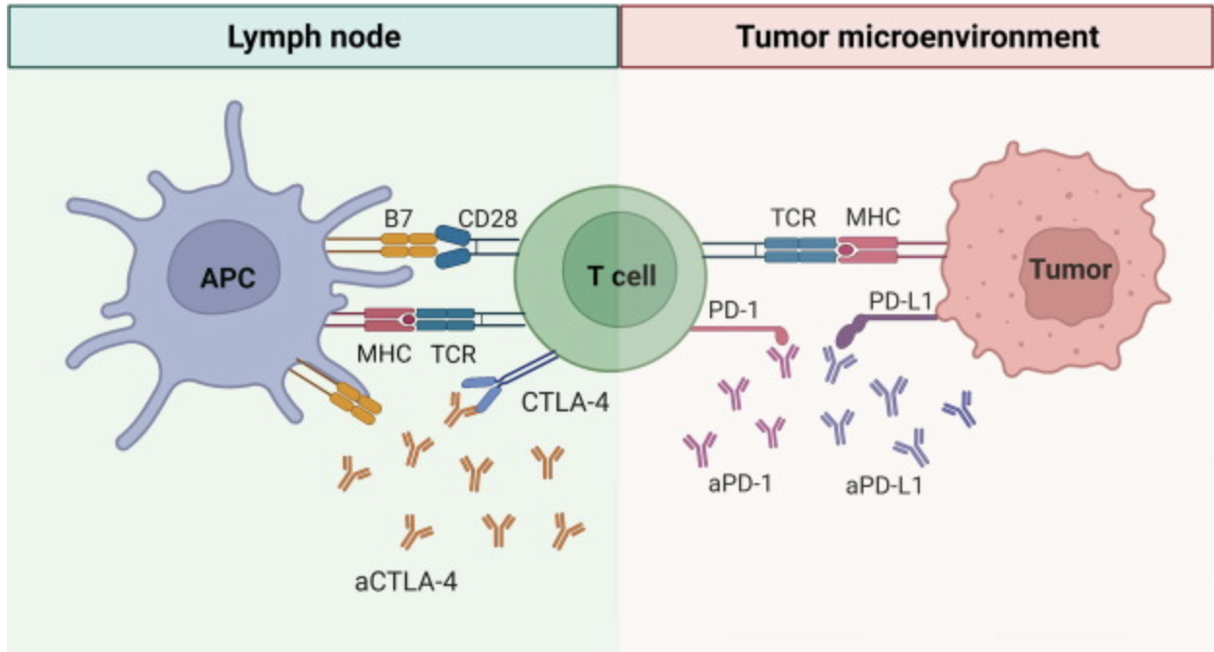
PD-1 and CTLA-4 blockade induce distinct responses despite both converging on Akt signaling
PD-1 blockade more CD8 (immune “normalizer”), CTLA-4 more CD4 (immune “enhancer”)
PD-1 blockade associated with fewer irAEs
PD-1 blockade induces more clonal TCR repertoire, CTLA-4 blockade induces more diversified TCR repertoire
Notes:
Picture: Advanced materials for management of immune-related adverse events induced by immune checkpoint inhibitors
Distinct cellular mechanisms underlie anti-CTLA-4 and anti-PD-1 checkpoint blockade
- PD-1 blockade predominantly induces expansion of specific tumor infiltrating exhausted-like CD8<sup>+</sup> T cell subsets
- CTLA-4 blockade induces expansion of ICOS<sup>+</sup> Th1-like CD4<sup>+</sup> effector T cells, also engages specific subsets of exhausted-like CD8<sup>+</sup> T cells
Immune-related adverse events in checkpoint blockade: observations from human tissue and therapeutic considerations
PD-1 blockade more CD8 effect, CD4 effect more for CTLA-4 blockade
Mechanisms of immune-related adverse events during the treatment of cancer with immune checkpoint inhibitors
anti-CTLA-4 and anti-PD-1/PD-L1 antibodies called "immune enhancers" and "immune normalizers" (normalizing T cell immunity in tumor microenvironment), respectively, consistent with PD-1 blockade having less irAEs
CTLA-4 and PD-1 signaling converge on Akt, regulator of T cell activation
CTLA-4 blockade induces more diversified T cells (including autoreactive ones), PD-1 blockade induce more clonal TCR repertoire and proliferation of intratumoral CD8<sup>+</sup> T cells

Slide 36
Effect of tumor type on ICB response
TMB generally a good predictor of ICB response
Good ICB responders
Melanoma
NSCLC
Colon/endometrium cancer (if MMRd and with high microsatellite instablility)
Poor ICB responders
Ovarian cancer
Notes:
ovarian cancers ICB resistant, not known why (perhaps TIM-3 checkpoint), despite tumor-infiltrating leukocytes present in most ovarian cancer patients (or perhaps these are bystanders reactive to viruses rather than tumor antigens)

Slide 37
Predictors of ICB response
Debate over TCR repertoire diversity/clonality predicting ICB response
Notes:
T cell repertoire diversity: friend or foe for protective antitumor response?
high TCR diversity/richness/evenness (all same here, highly polyclonal synonyms) in blood associated with good ICB outcome
# A multi-omic single cell sequencing approach to develop a CD8 T cell specific gene signature for anti-PD1 response in solid tumors
- **neither pre-treatment TCR clonality nor changes in clonality after ICB correlate with response**
Single cell T cell landscape and T cell receptor repertoire profiling of AML in context of PD-1 blockade therapy
- TCR repertoires expand in responders, contract in therapy resistant patients
some circulating PD-1<sup>+</sup> CD8<sup>+</sup> T cells share TCR sequences with T cells in TME, and this frequency predicts ICB response
in responsive patients peripheral compartment is a major source of T cells activated by ICB and majority of pre-existing intratumoral T cells are terminally exhausted and refractory to ICB

Slide 38
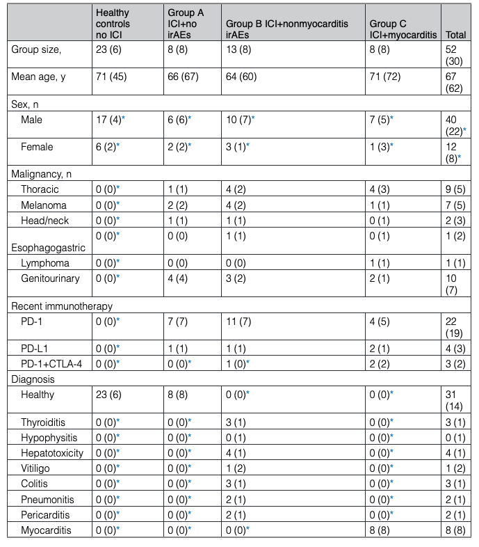
Myocarditis dataset patient demographics

Slide 39
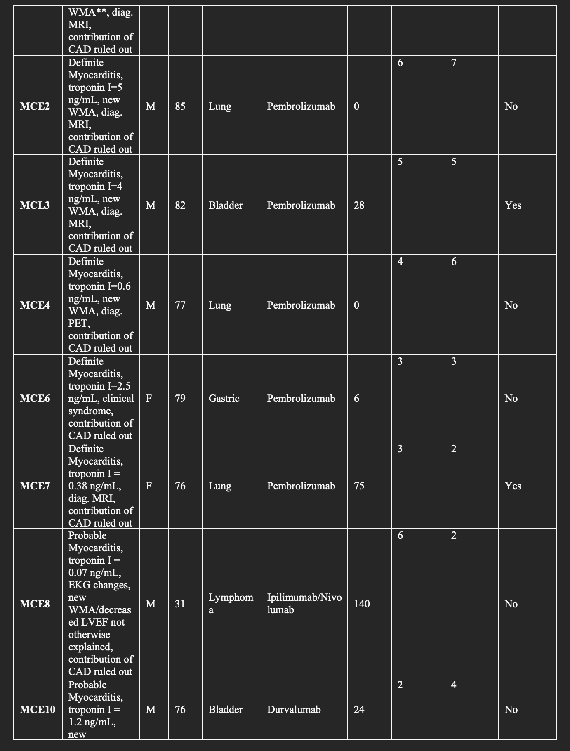
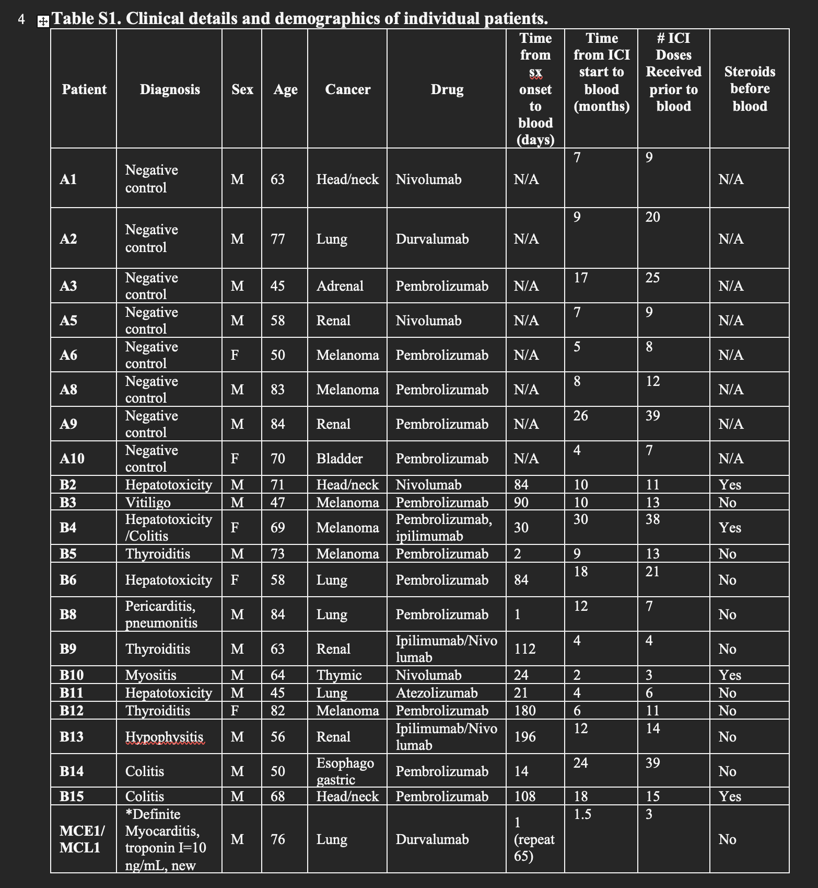
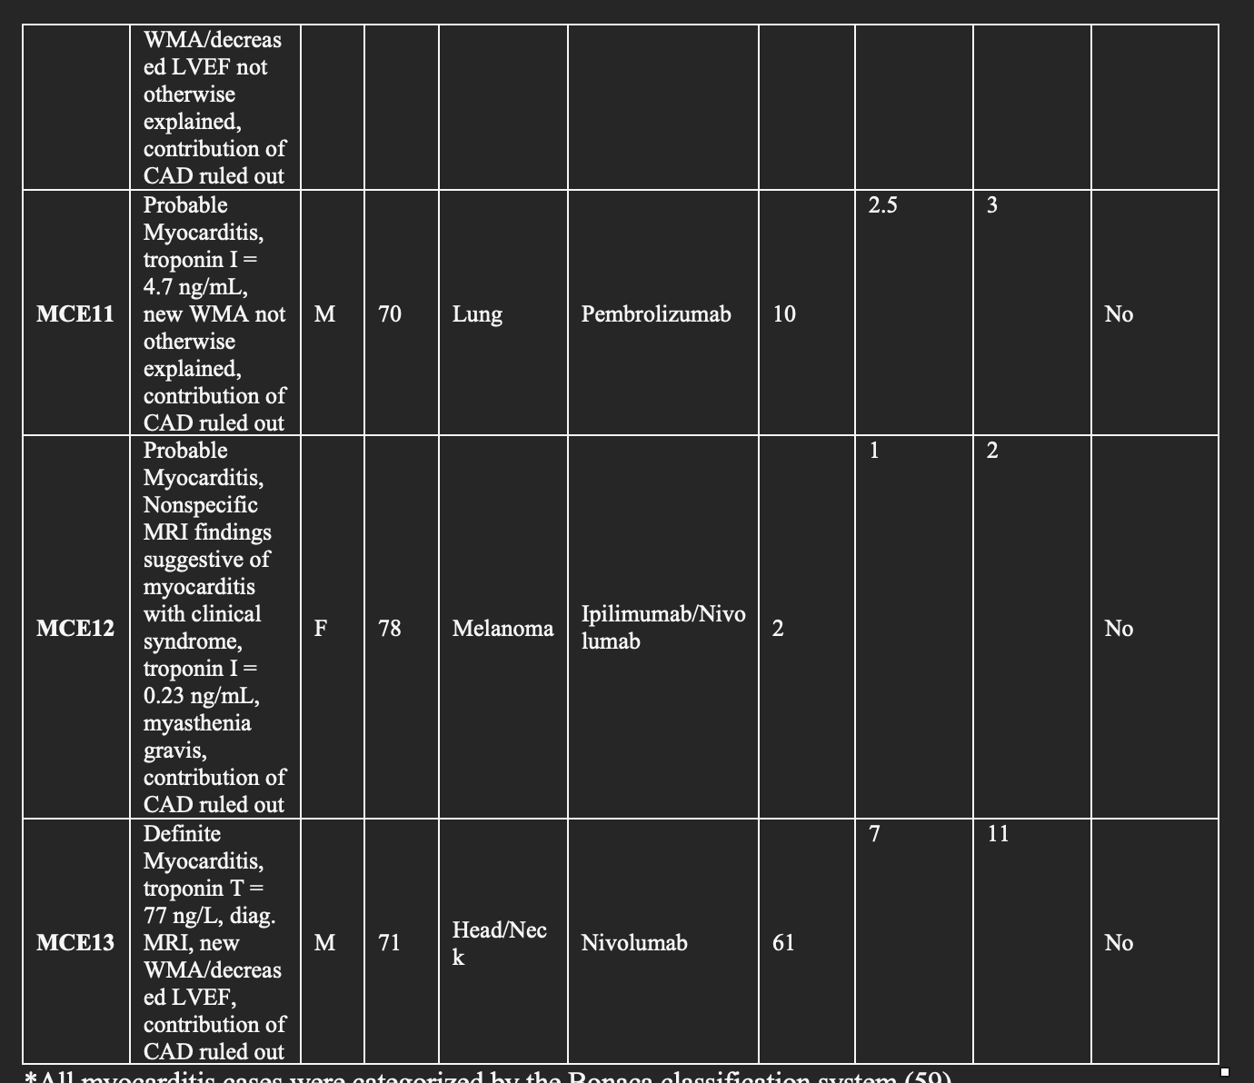
Specific myocarditis dataset patient info

Slide 40
irAEs vs. autoimmune conditions
irAEs progress more rapidly, more transient, often display quicker recovery than autoimmune conditions
Notes:
Immune-related adverse events in various organs caused by checkpoint inhibitors
irAEs progress more rapidly than autoimmune conditions, also transient often with quick recovery
severe irAEs may represent a subclinical or latent autoimmune state that is unmasked upon ICI treatment

